Slide 1
Discussion group
CM SAF User Workshop 29 Jan 2024
Water cycles, extremes, climate indices:
Evapo(trans)piration, sensible heat flux, precipitation, land surface temperature
Contributors: H. Konrad, W. Moutier, A. Tetzlaff, A. Cheda

Slide 2
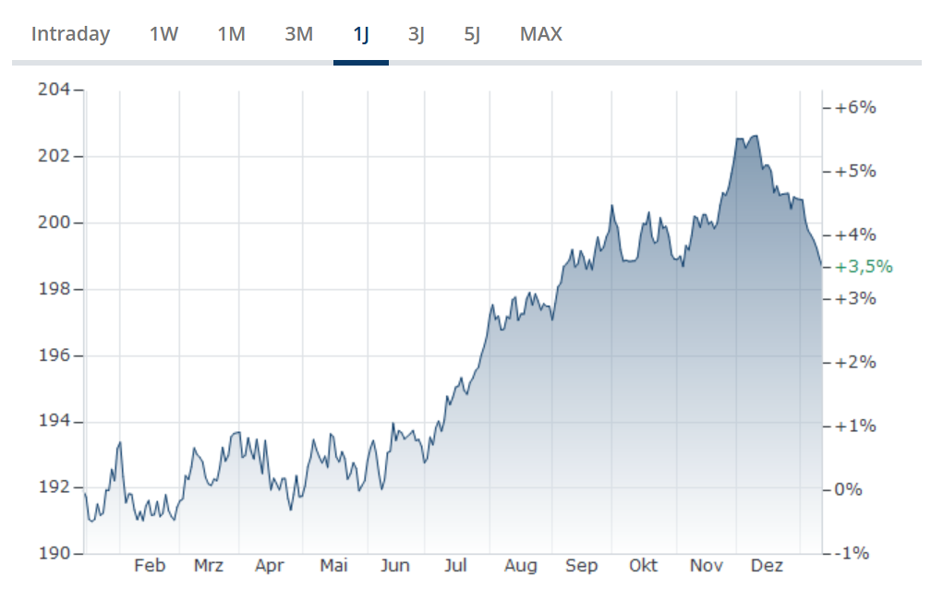
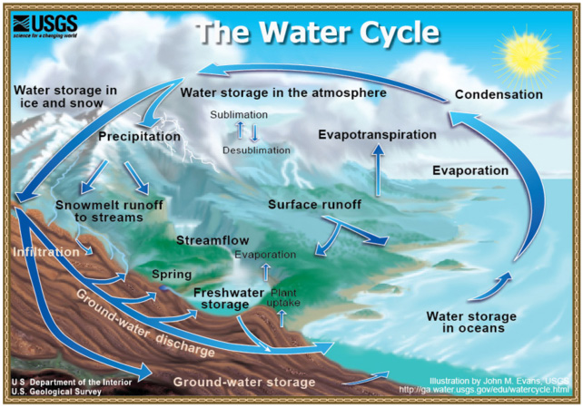
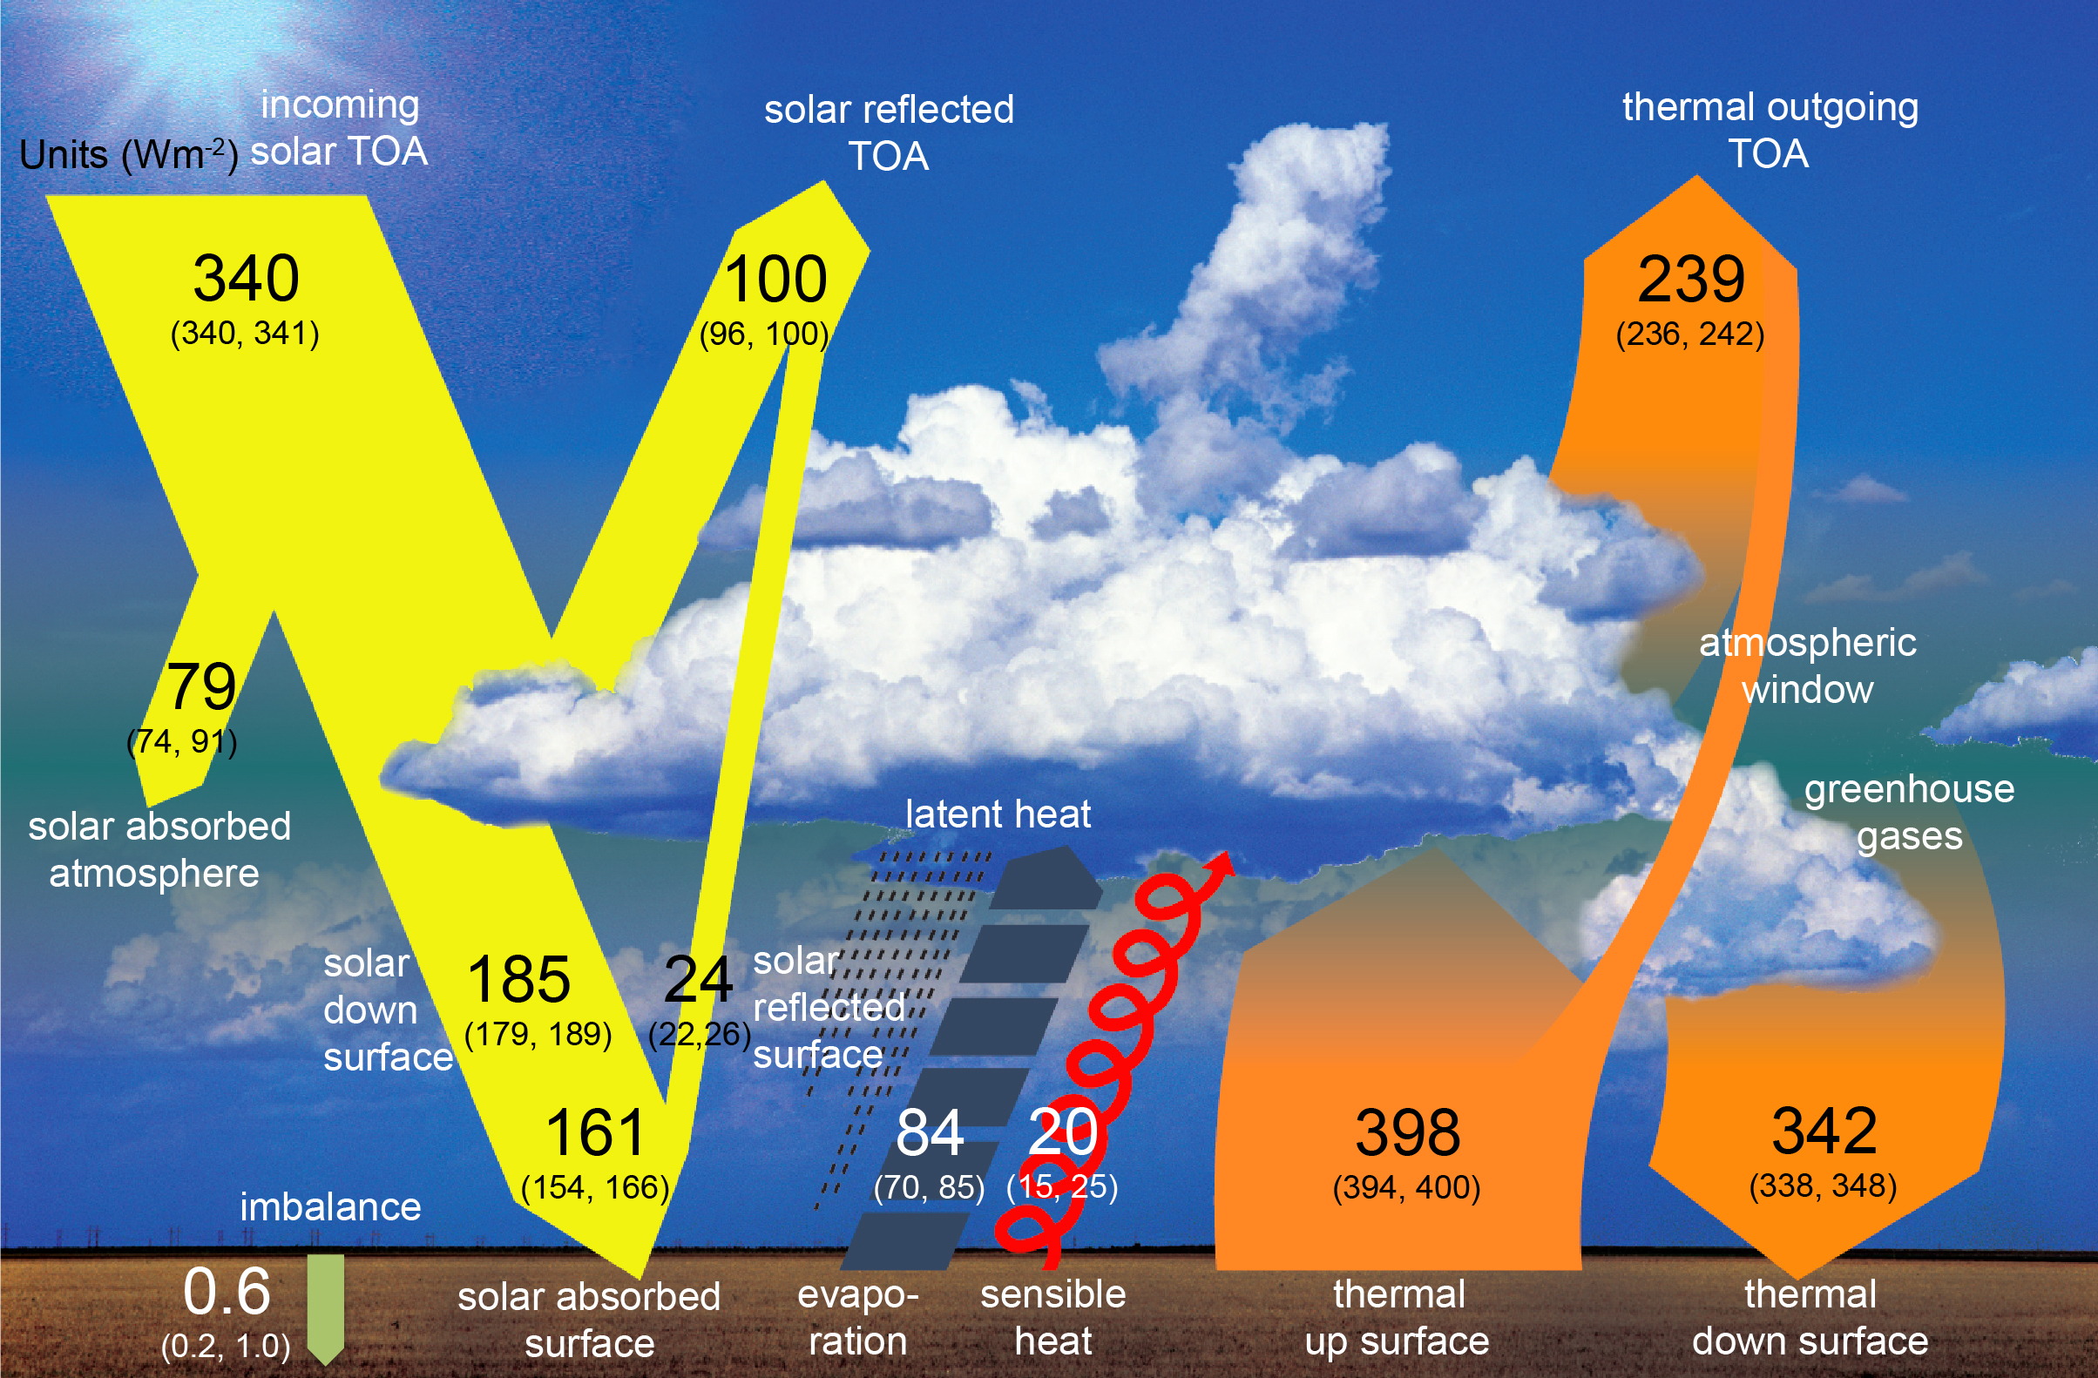
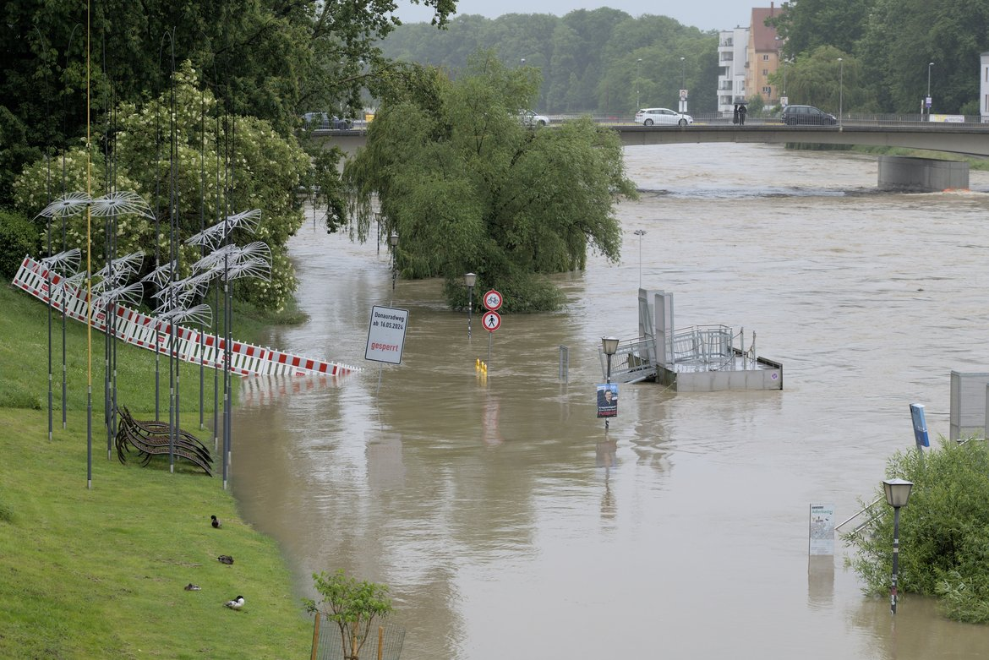
Setting the stage
Wild et al. (2013)
finanzen.net
+ LST
wikimedia commons - stk

Slide 3
Seeding questions
Which CM SAF data and services do you use for your analysis or application?
Which data or services are missing for your analysis or application?
How can CM SAF improve the products or services for your analysis or application (technically and scientifically)?
Reminder: We are 3 years into our current 5 year phase and are making plans for the next one.
Another reminder: This is the discussion group about water cycles, extremes, climate indices:
evapo(trans)piration, sensible heat flux, precipitation, land surface temperature

Slide 4
Outline for the discussion group
A quick (!) presentation of relevant CM SAF climate data records
A couple of examples of how these datasets have been or could be used for
  Water cycle analysis
  Extremes
  Climate indices
And then it‘s back to the questions for our discussion.

Slide 5
CM SAF Datasets
See also the posters

Slide 6

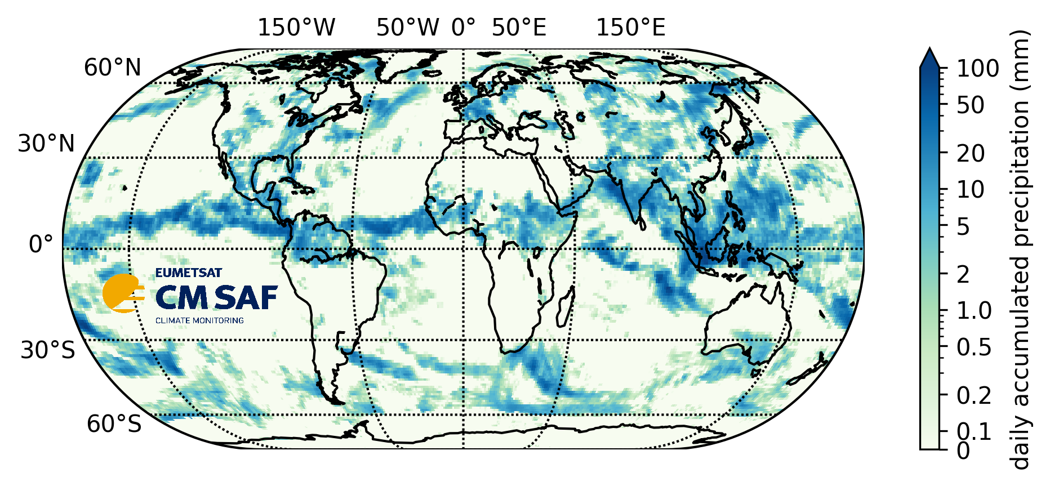
GIRAFE v1: CM SAF Global Interpolated RAinFall Estimation version 1
Continuous extension coming up
https://doi.org/10.5676/EUM_SAF_CM/GIRAFE/V001
Publication year 2024
Version 1.0
Temporal coverage
2002-01-01 - 2022-12-31
Geographic coverage Global
Resolution 1° daily and monthly
GIRAFE v1 daily / 12. Juli 2021

Slide 7
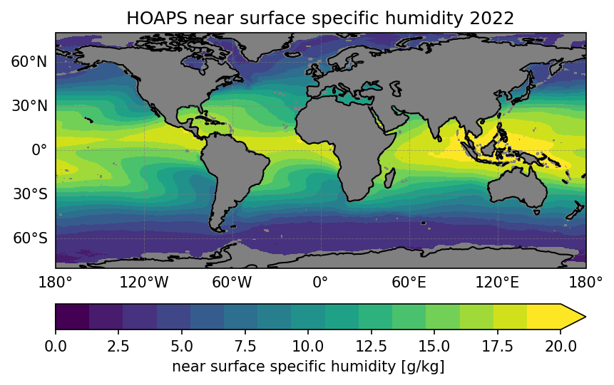
Hamburg Ocean Atmosphere Parameters and Fluxes from Satellite Data - HOAPS 4.0
New version coming up
Continuous extension possible from next phase
https://doi.org/10.5676/EUM_SAF_CM/HOAPS/V002
Publication year 2017
Version 4.0
Temporal coverage
1987-07-01 - 2014-12-31
Geographic coverage
Quasi-global ice-free ocean
Resolution 0.5° 6-hourly and monthly
Total column water vapour (plus extension over land via ESA CCI activities
Latent heat flux and evaporation
Precipitation (in the form of E-P)

Slide 8
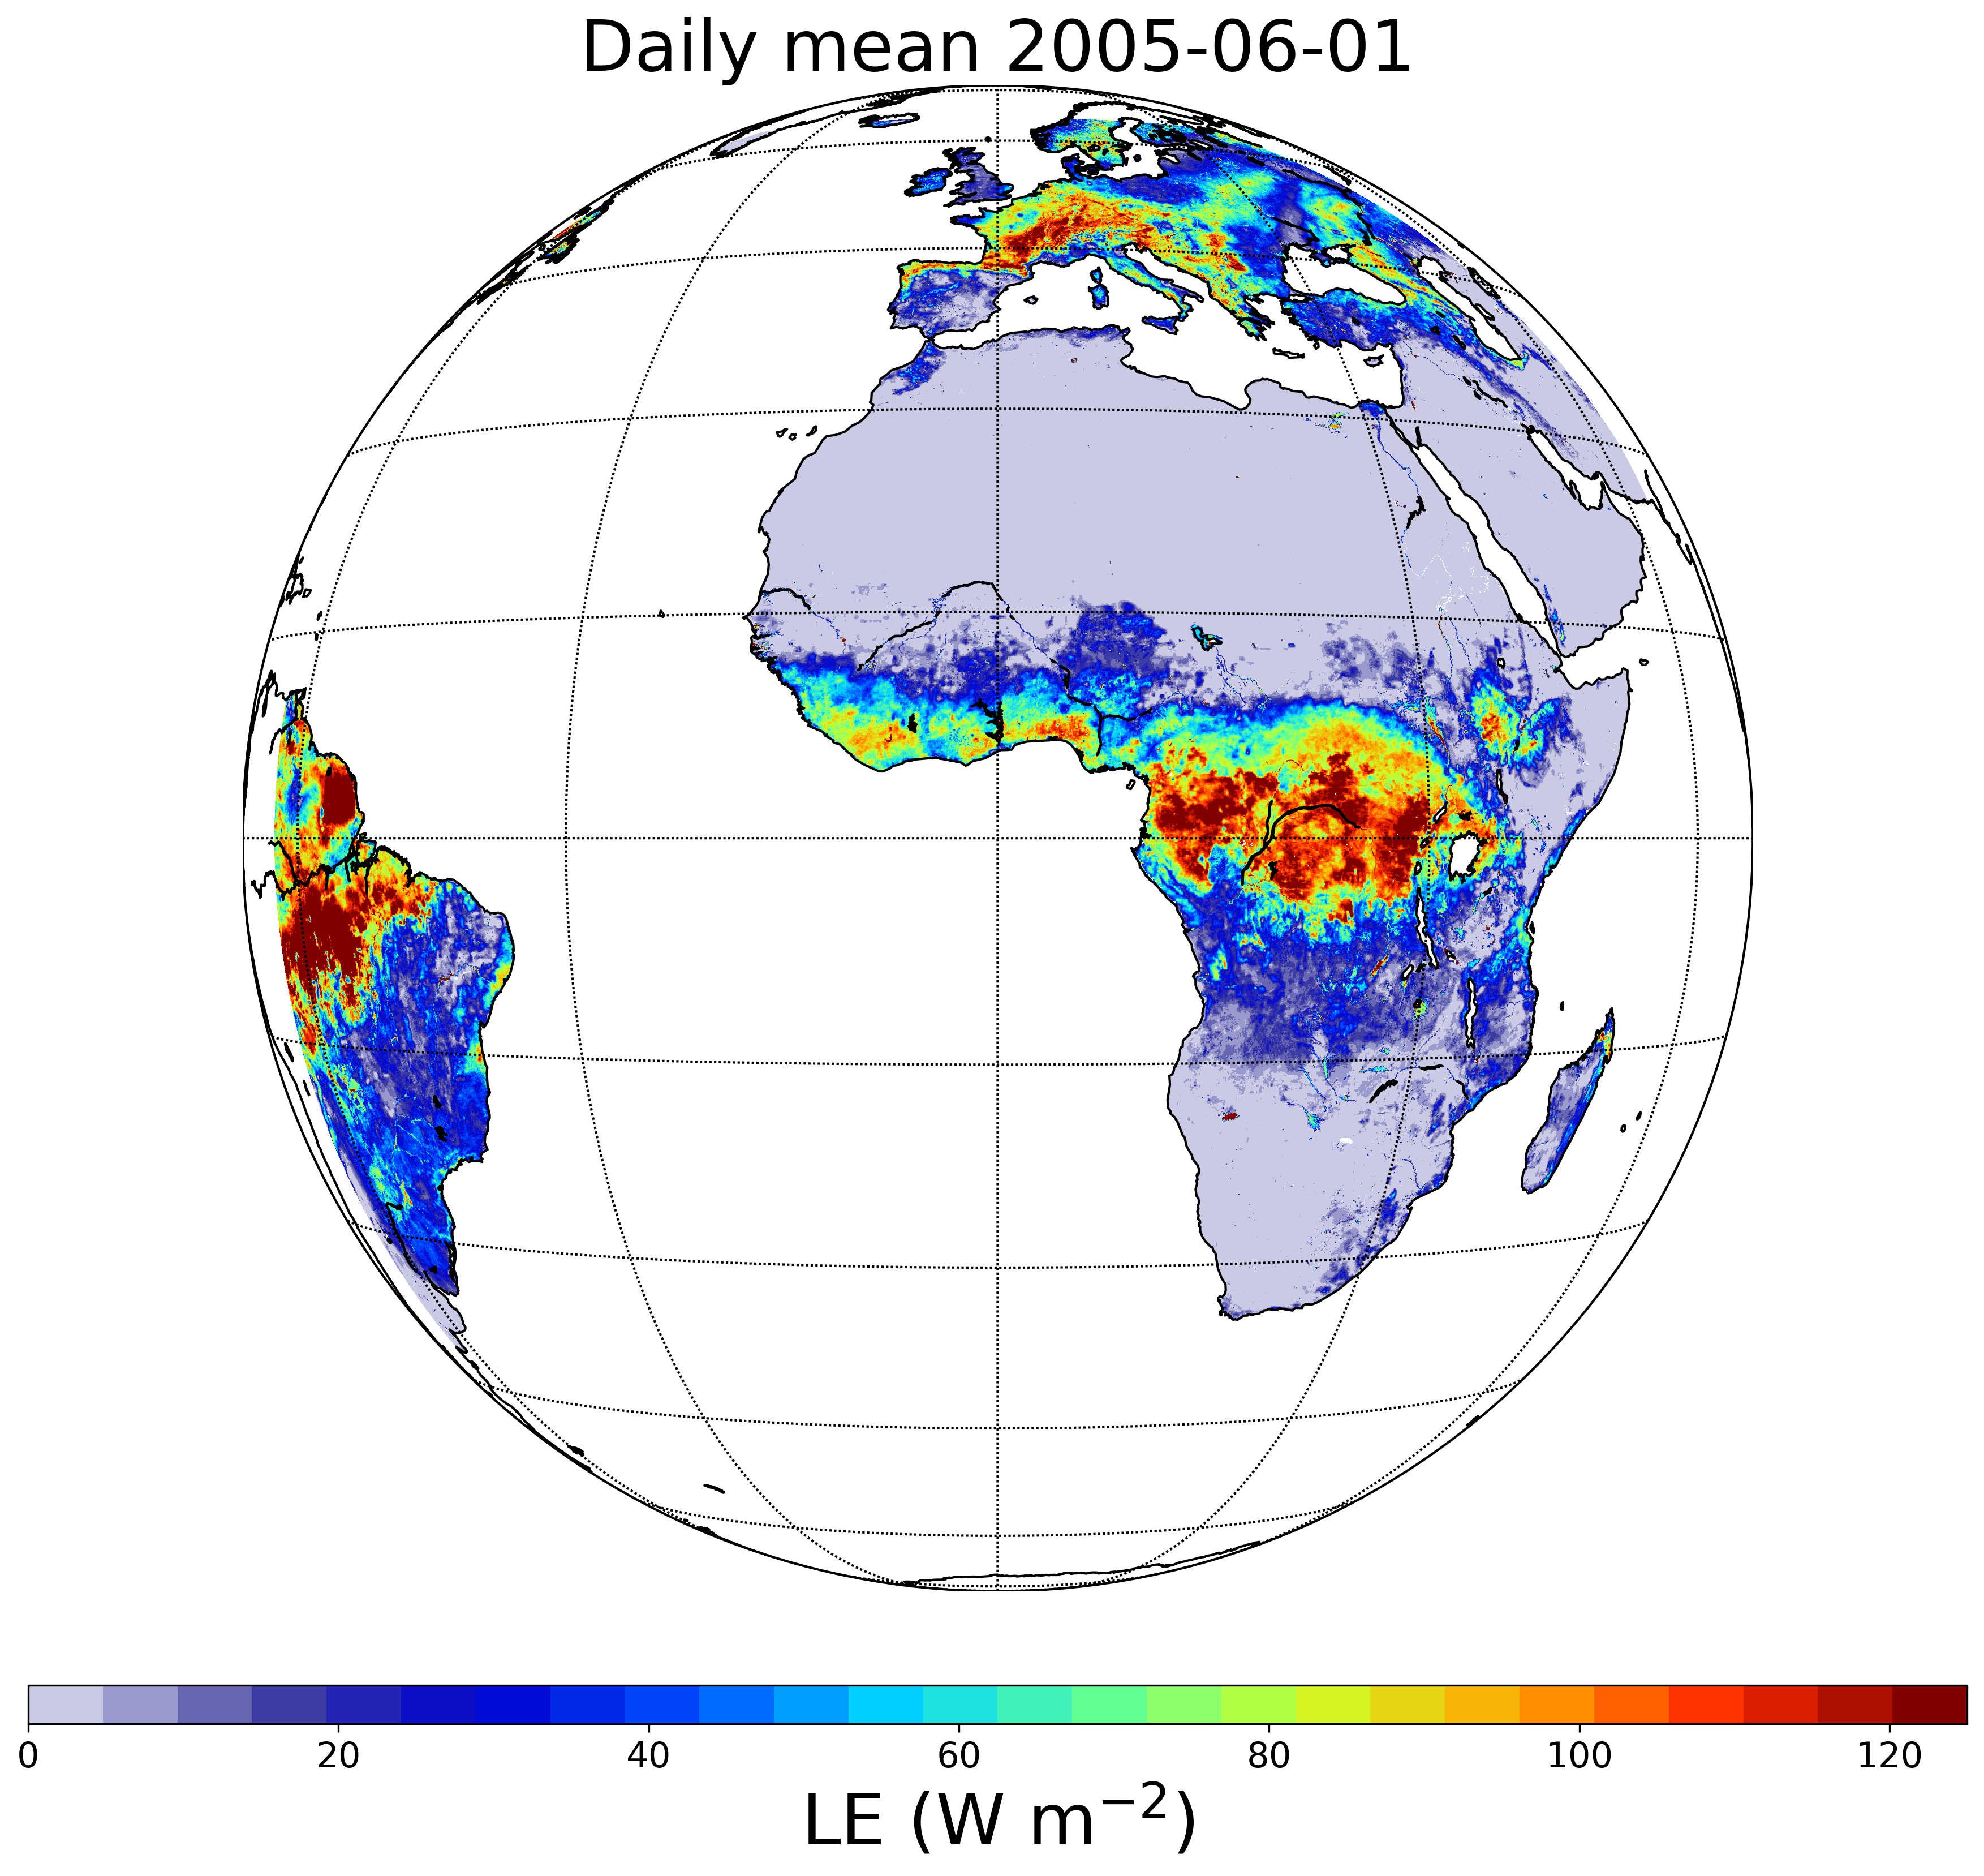
CM SAF Surface Radiation and Fluxes from Meteosat First and Second Generation - Edition 1 (LANDFLUX Ed. 1)
https://doi.org/10.5676/EUM_SAF_CM/SLF_METEOSAT/V001
Publication year 2024
Version 1.0
Temporal coverage
1983-01-01 - 2020-12-31
Geographic coverage Meteosat
Resolution
Hourly, daily, monthly 0.05°
Latent heat flux and evapotranspiration
Sensible heat flux

Slide 9
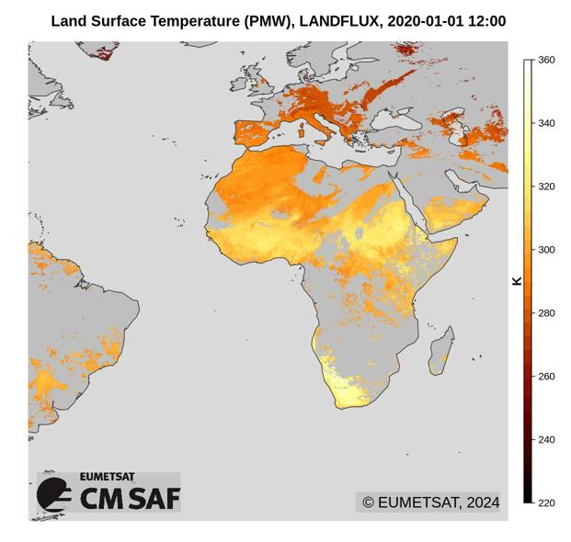
CM SAF Land SUrface Temperature dataset from METeosat First and Second Generation - Edition 2 (SUMET Ed. 2)
https://doi.org/10.5676/EUM_SAF_CM/LST_METEOSAT/V002
Publication year 2024
Version 2.0
Temporal coverage
1983-01-01 - 2020-12-31
Geographic coverage Meteosat
Resolution
Hourly, monthly mean diurnal cycle 0.05°

Slide 10
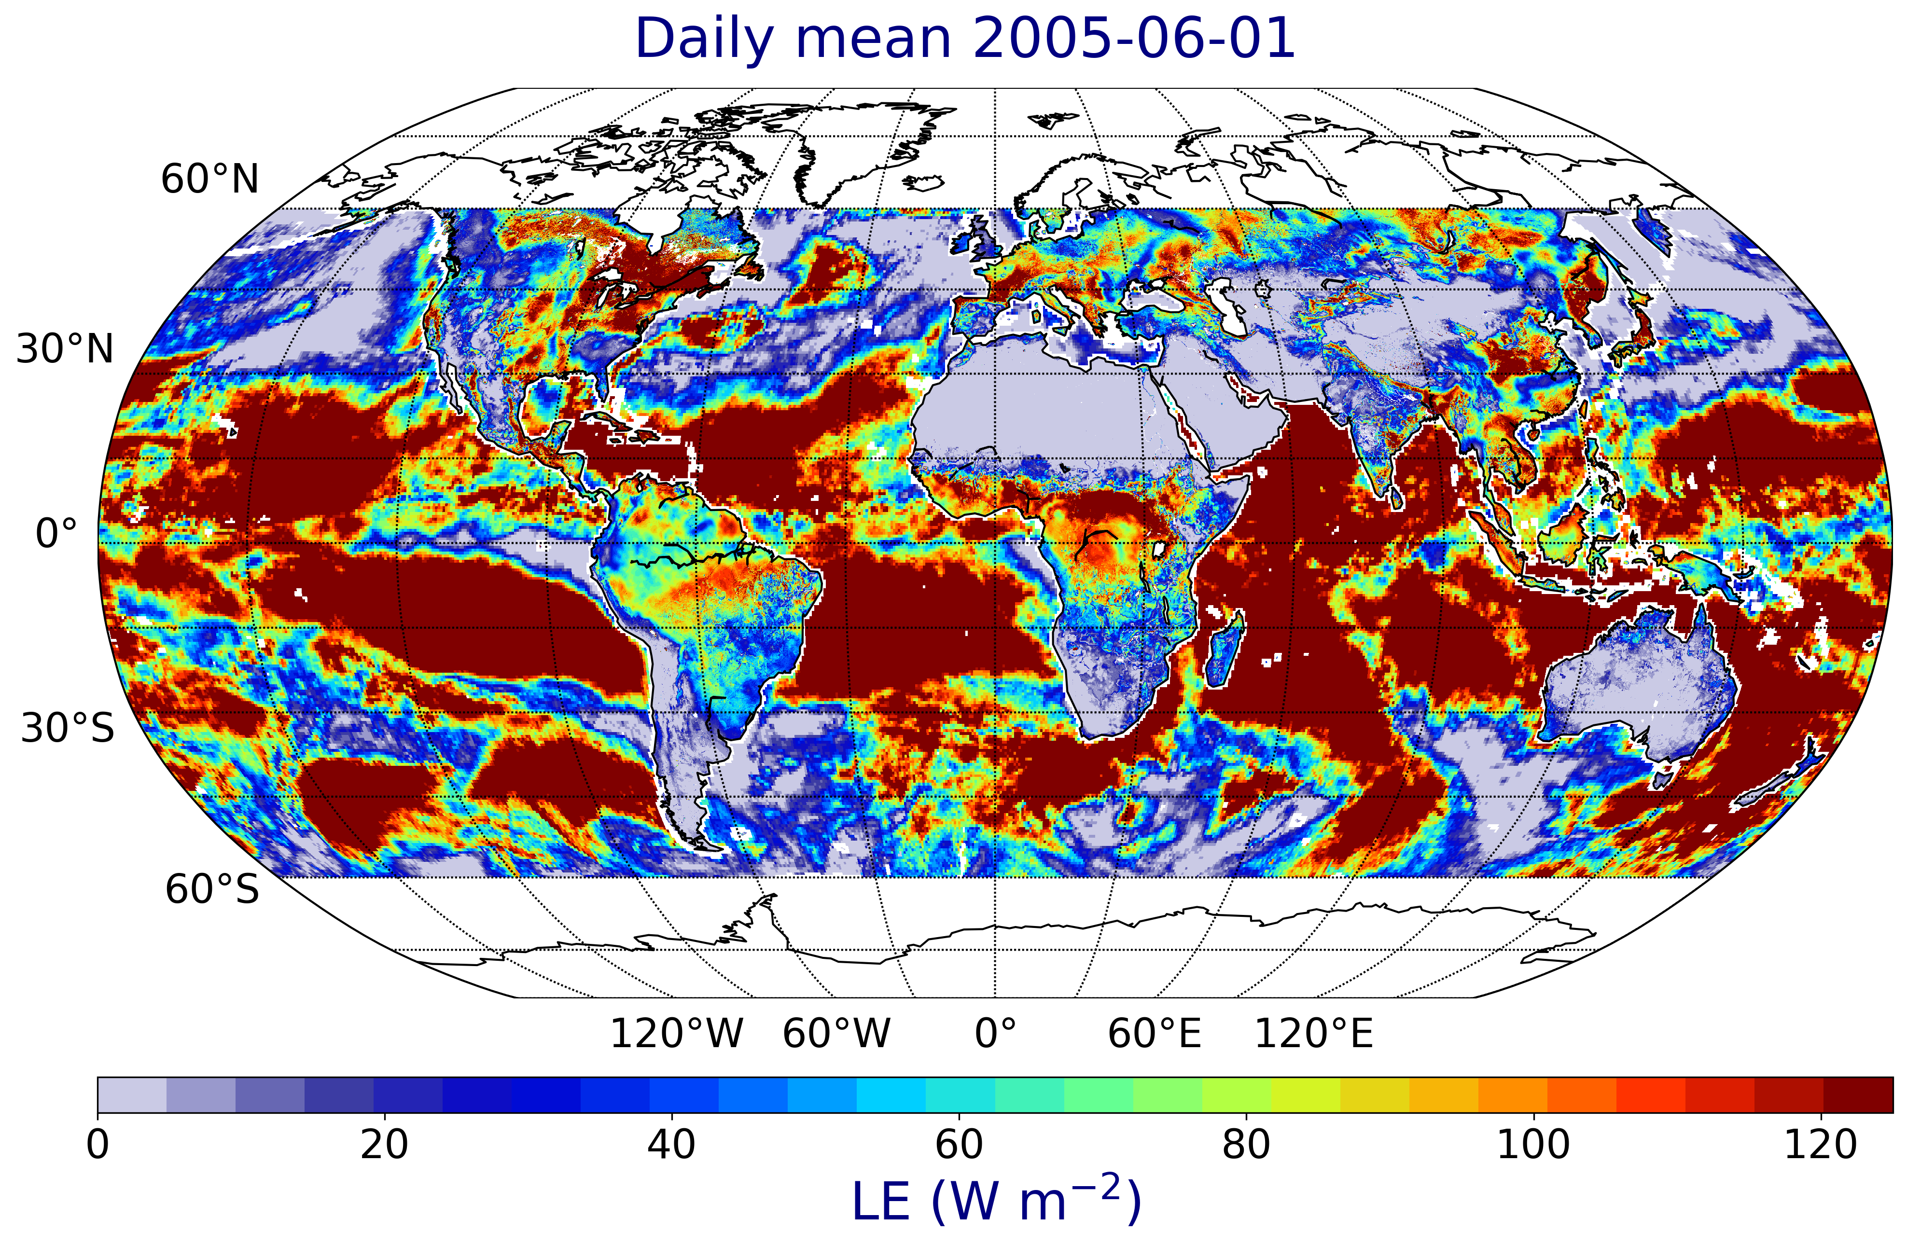
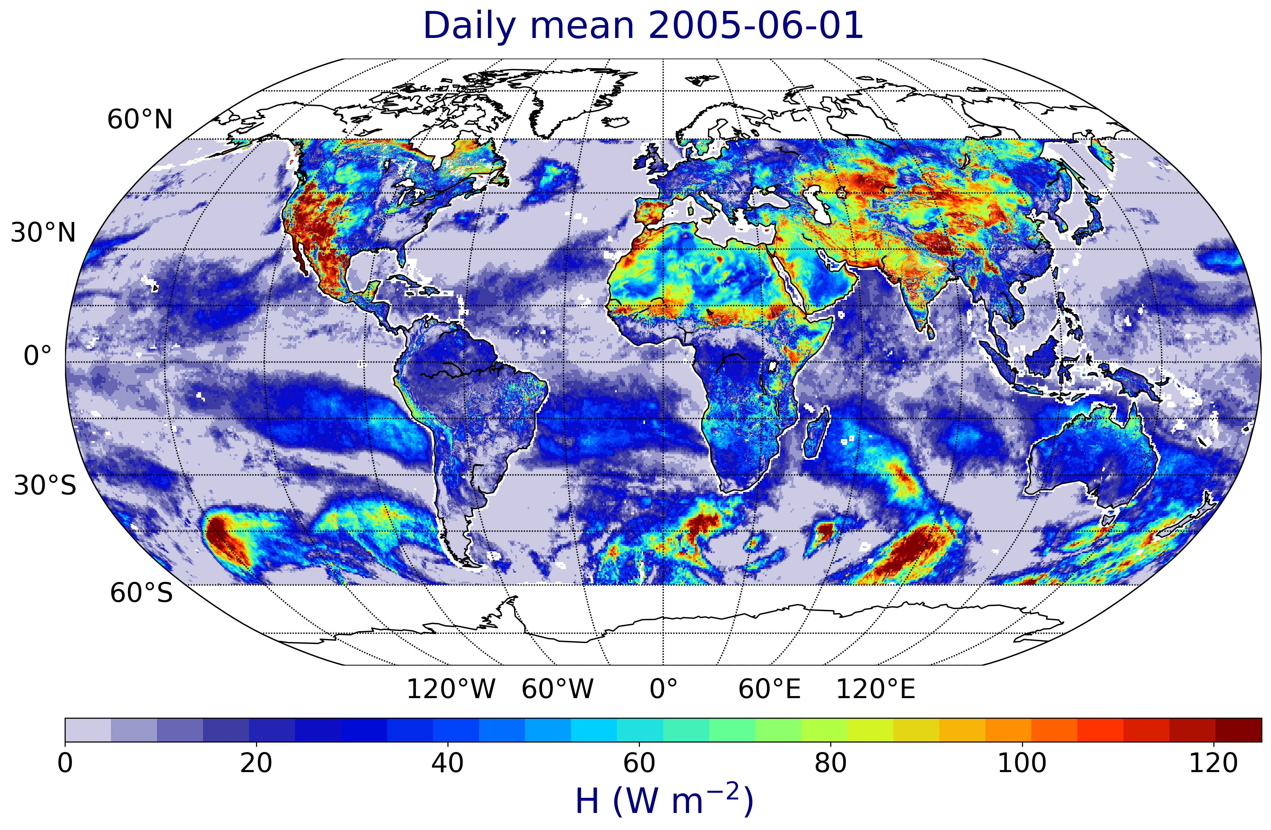
Current activities: Meteosat to Georing
Filled here over ocean with HOAPS 4.0 for latent and sensible heat flux
Same activity for land surface temperature
Demonstrator status in this phase

Slide 11
A couple of examples

Slide 12
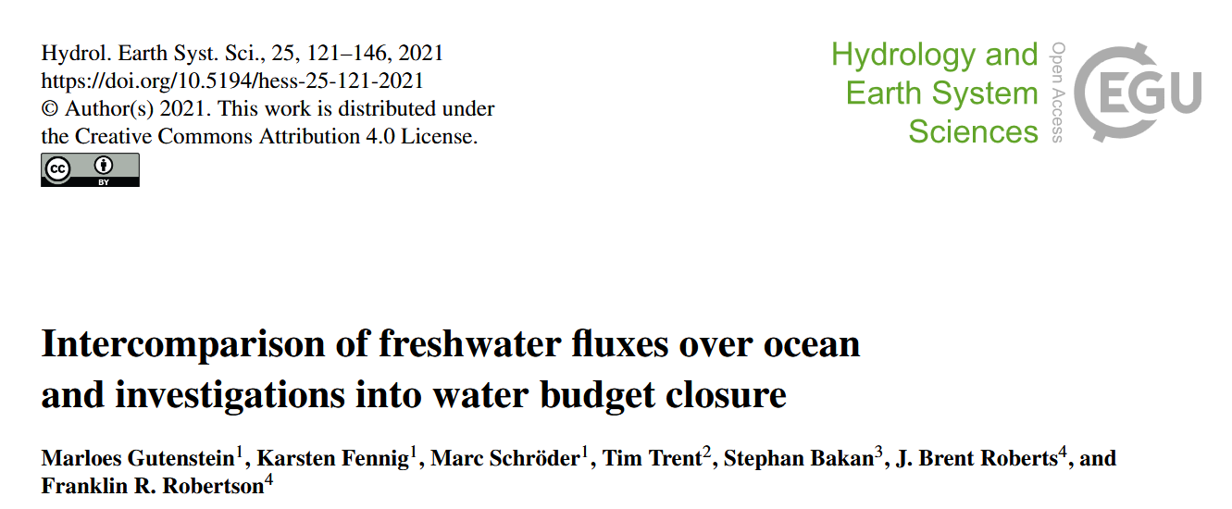
Water cycle I

Slide 13
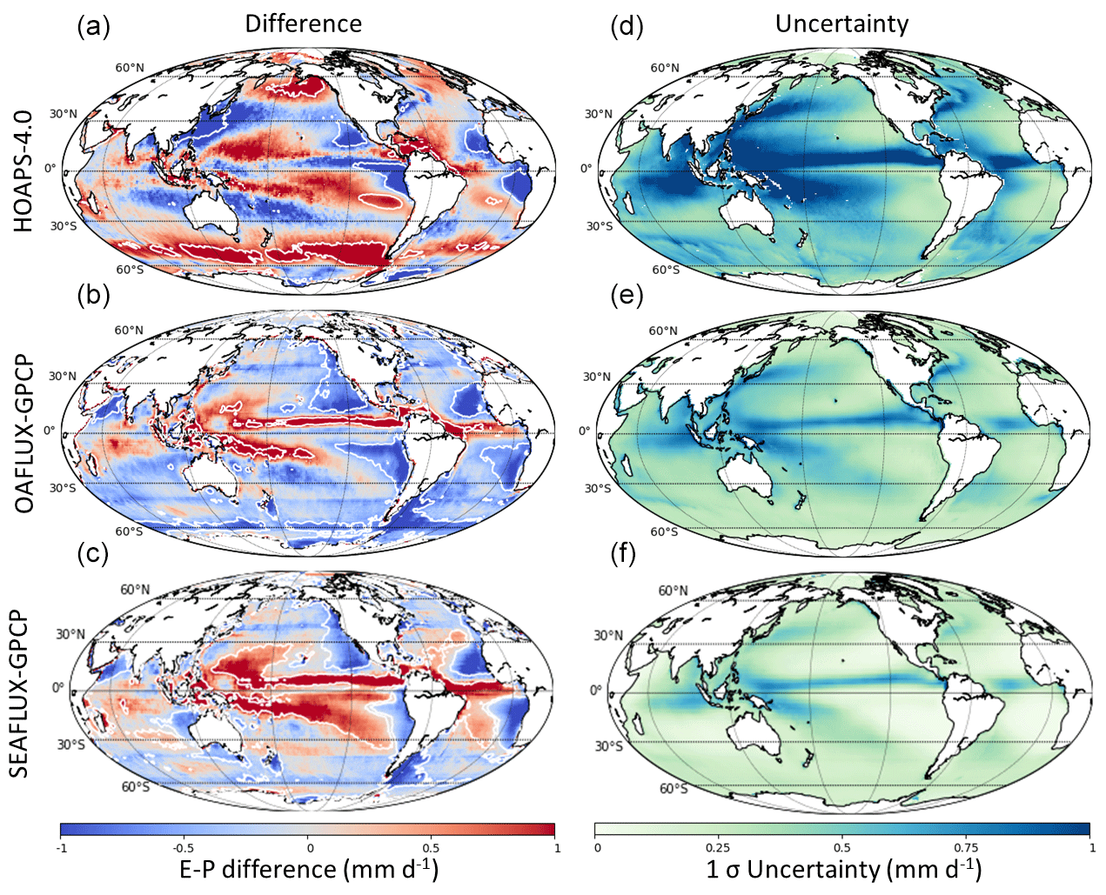
Water cycle I
[…] we compare six recent satellite-based retrieval algorithms and ERA5 […] freshwater flux (E−P) data regarding global and regional, seasonal and interannual variation to assess the degree of correspondence among them. […]
One main finding of our study is the agreement of global ocean means of all E−P data sets within the uncertainty ranges of satellite-based data. Regionally, however, significant differences are found among the satellite data and with ERA5. […]
Difference maps of climatological mean E−P minus the corresponding collocated ERA5 climatology (1997–2013)

Slide 14
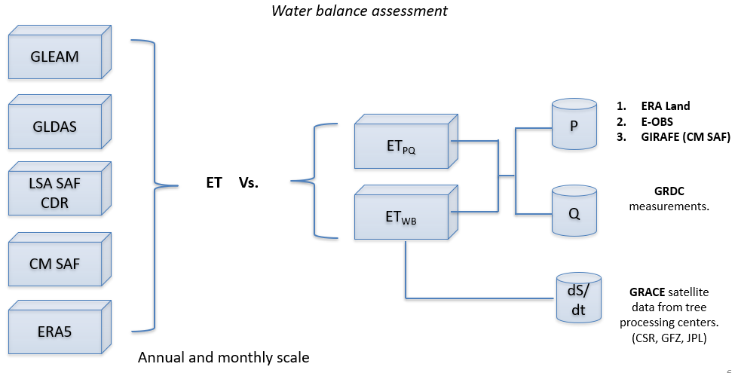
Water cycle II: regional
CM SAF use case: work in progress at RMIB

Slide 15
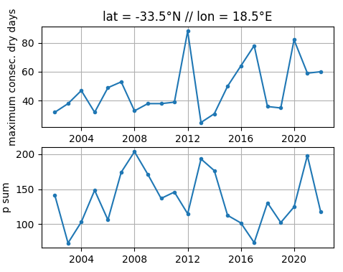
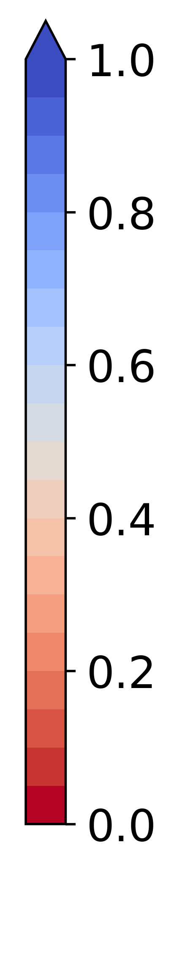
Extremes / indices: drought
GIRAFE v1 1DD grid cell for Cape Town
Evaporative fraction (EF) in the Cape Town area from the Meteosat-based latent and sensible heat fluxes in June (winter)
EF
Max. length of dry spell (days)
2017: lake levels unreplenished
Total precipitation
(mm)

Slide 16
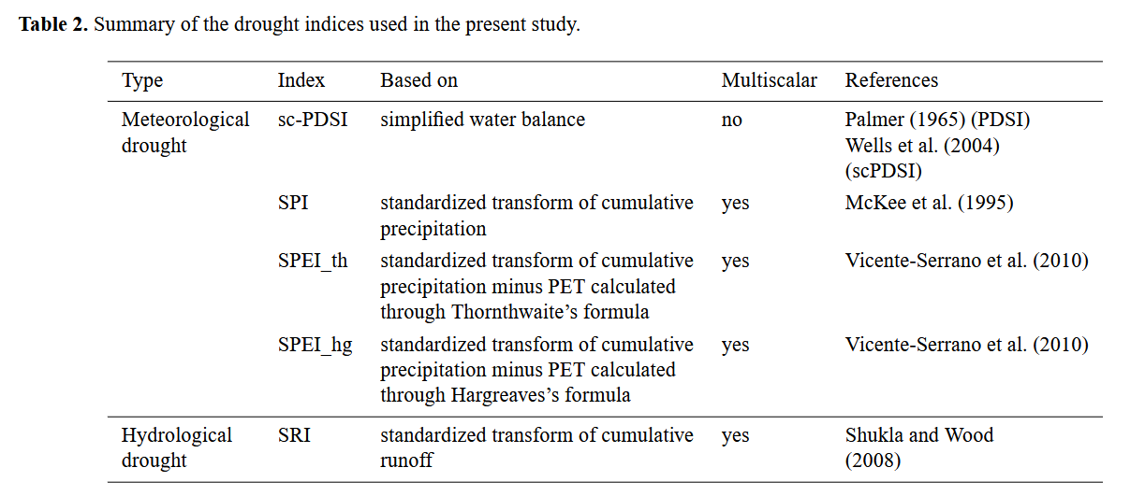
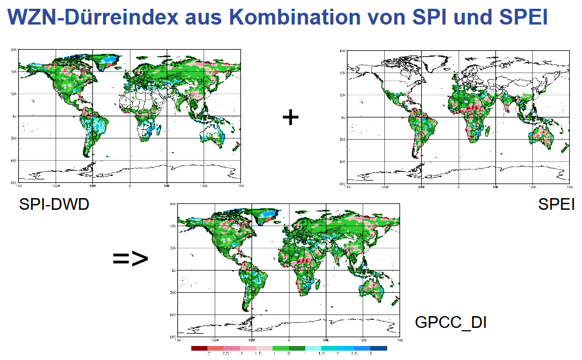
Extremes / indices: drought
GPCC Drought Index
Joetzjer et al.,
HESS, 2013
Ziese et al., ESSD, 2014

Slide 17
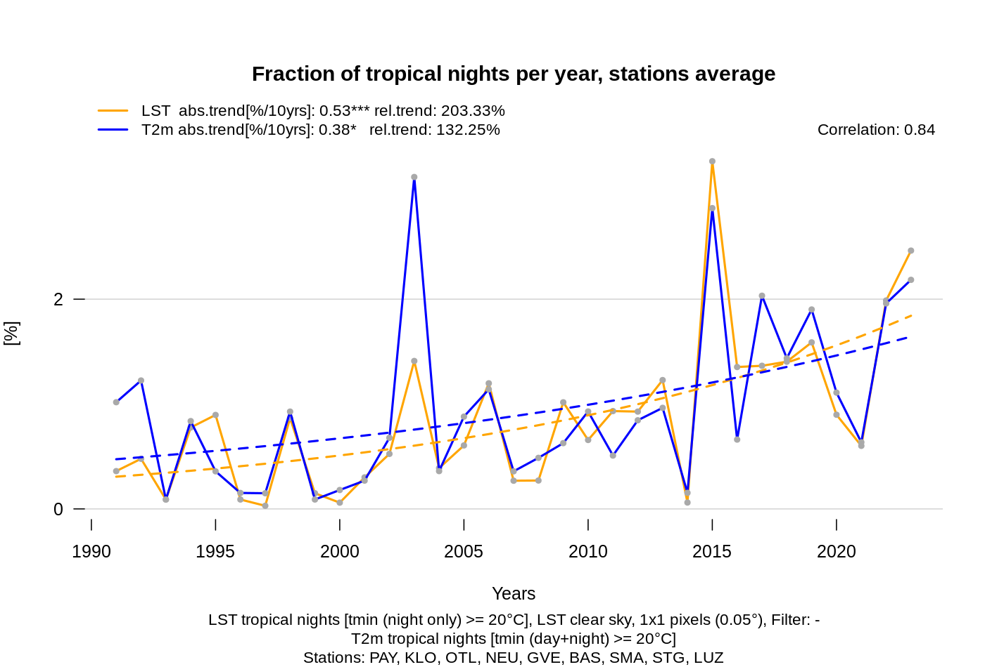
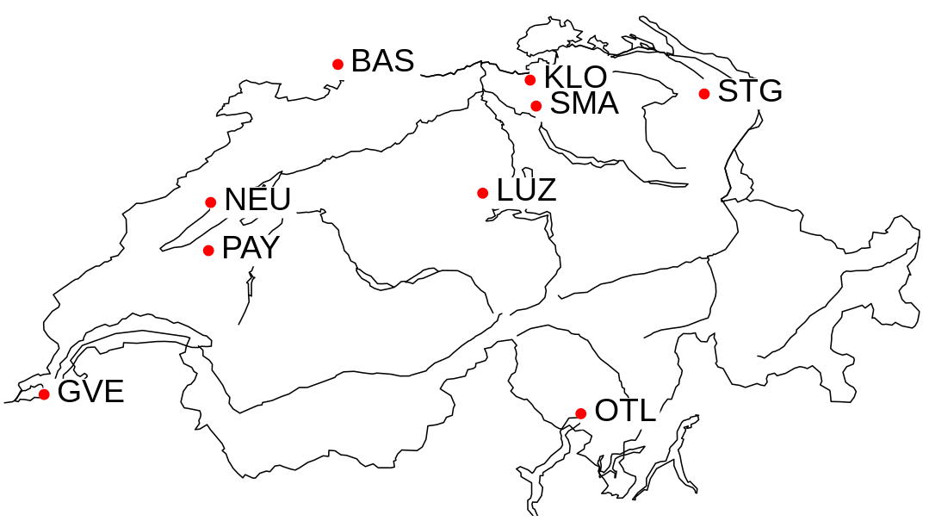
Extremes / indices: LST / tropical nights
Surface temperature at night > 20°C

Slide 18
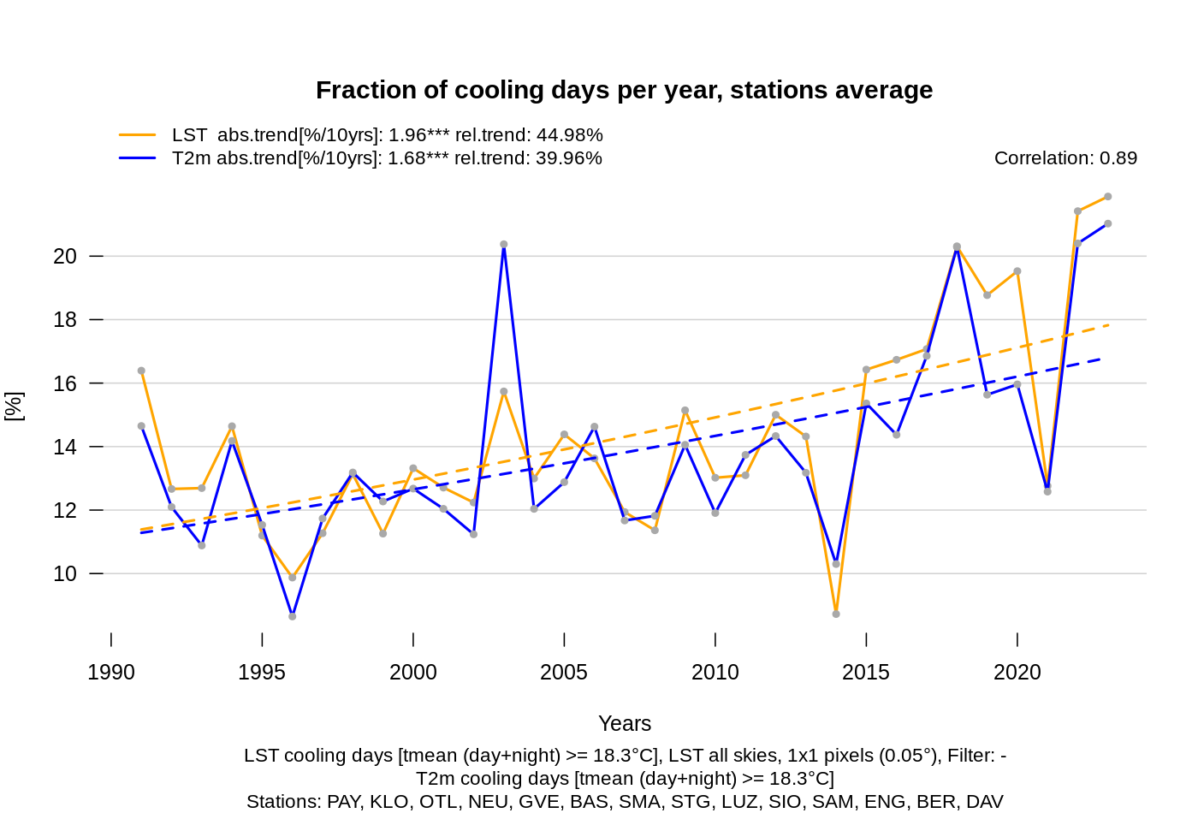
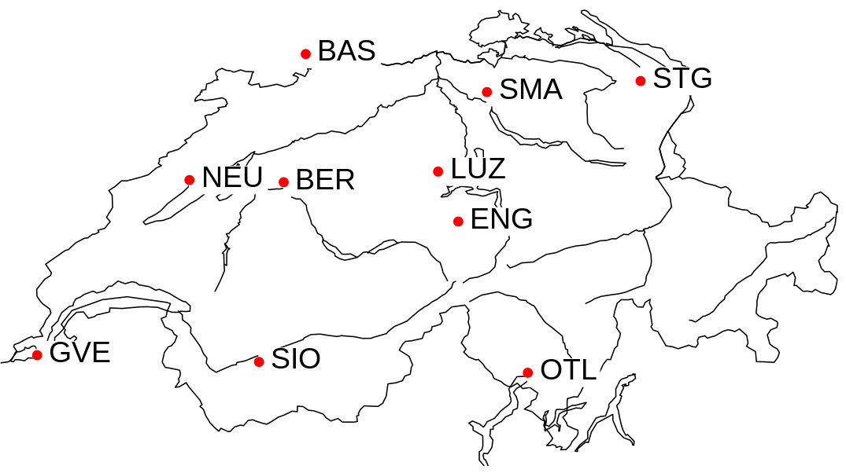
Extremes / indices: LST / cooling days
Surface temperature > 18.3°C

Slide 19
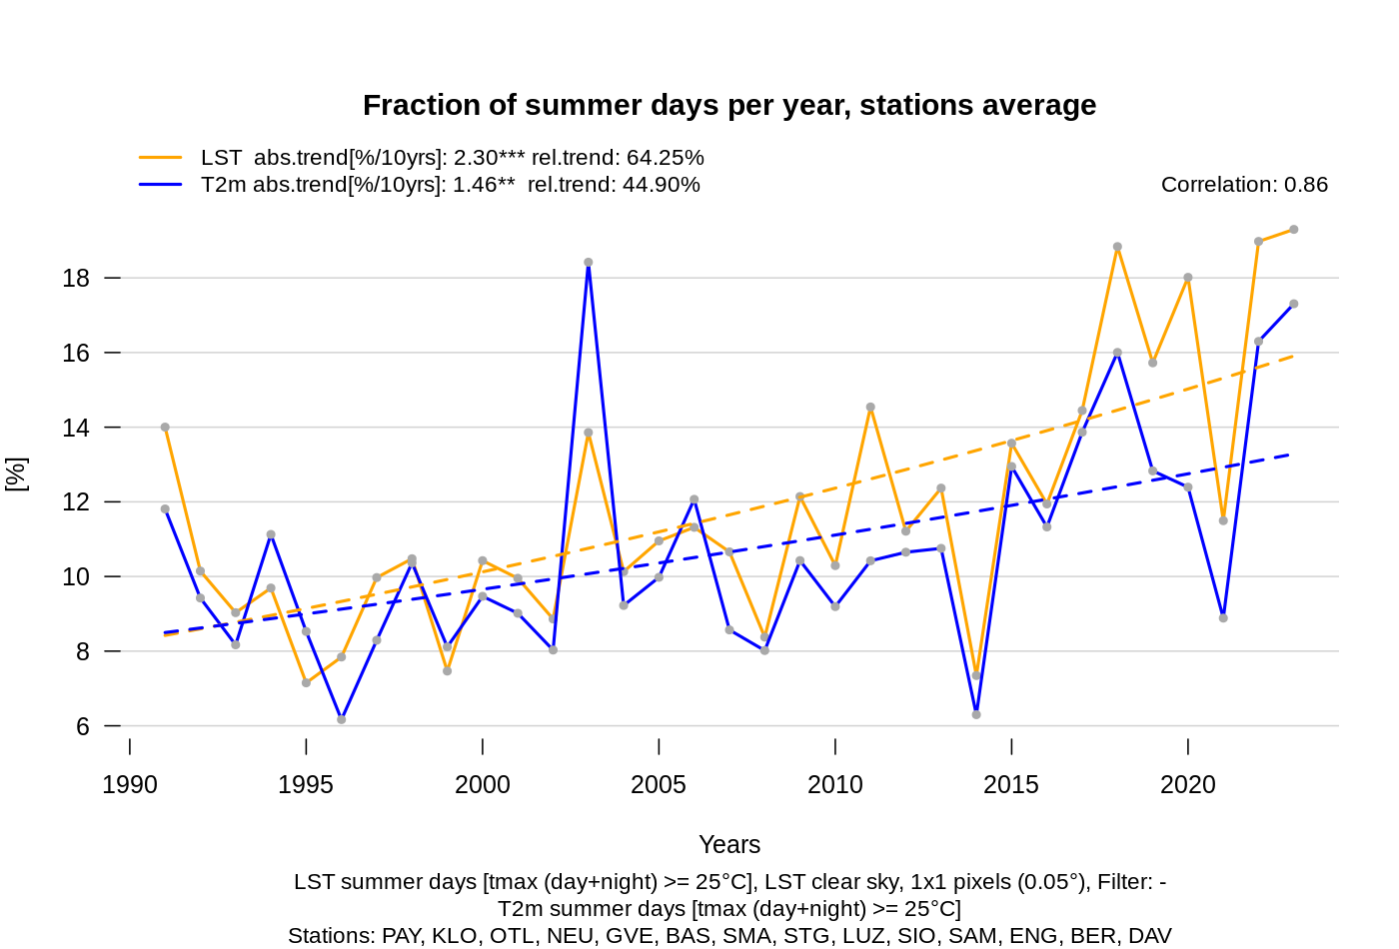
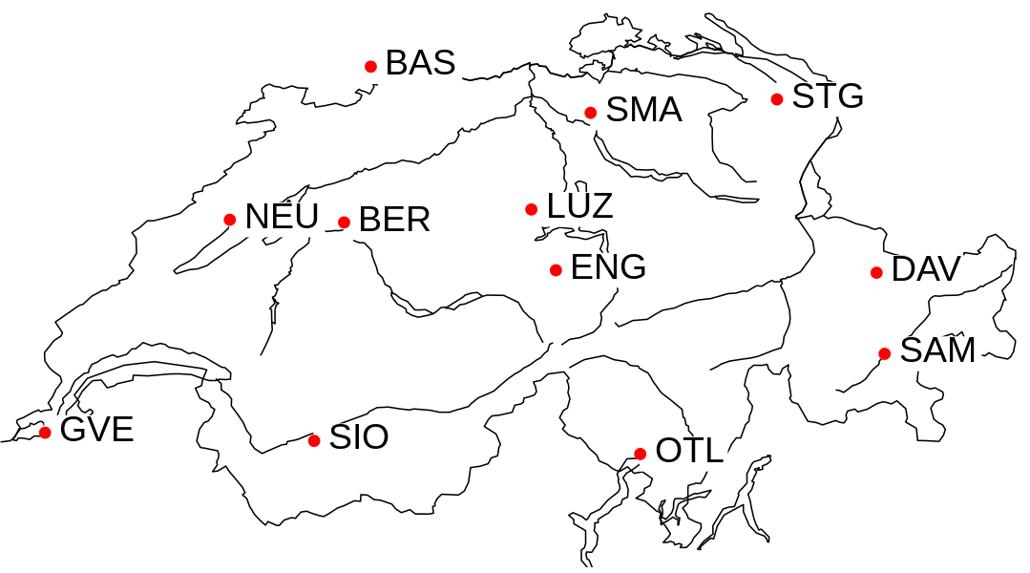
Extremes / indices: LST / summer days
Surface temperature > 25°C

Slide 20
A couple of additional thoughts on climate indices
There are obviously too many climate indices to list here
What are your relevant indices?
From the seed questions: As we are planning for our next phase: In your opinion, who should produce climate indices based on our datasets?
  You with your very own requirements in mind, or
  We as data providers in the form of an additional service? (subject to other considerations, too)

Slide 21
Seeding questions
Which CM SAF data and services do you use for your analysis or application?
Which data or services are missing for your analysis or application?
How can CM SAF improve the products or services for your analysis or application (technically and scientifically)?
Which climate indices are you interested in?
Which application around the water cycle variables, LST, sensible heat flux are you interested in?
Reminder: We are 3 years into our current 5 year phase and are making plans for the next one.
Another reminder: This is the discussion group about water cycles, extremes, climate indices:
evapo(trans)piration, sensible heat flux, precipitation, land surface temperature

