Slide 1

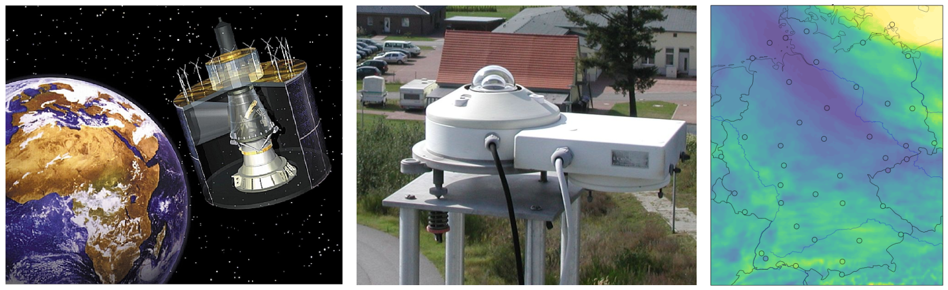
Combination of satellite and ground measurements of hourly surface solar radiation data in Germany (DUETT)
Sven Brinckmann and Jörg Trentmann

Slide 2
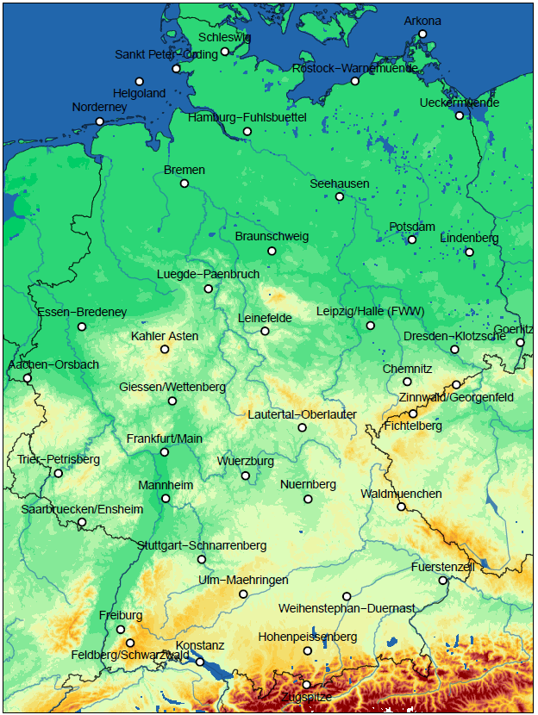
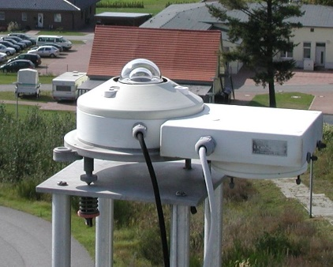
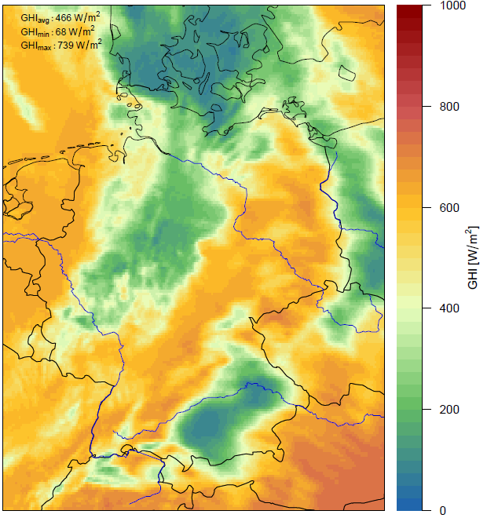
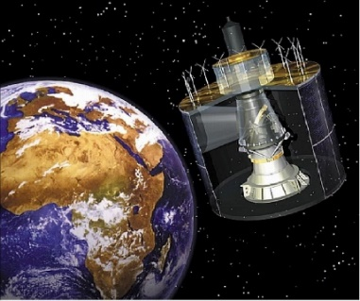
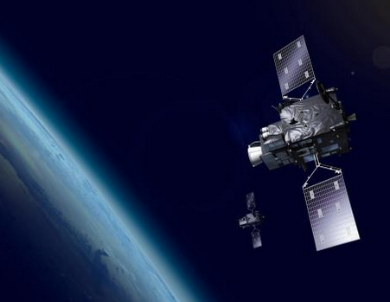
Surface Measurements Satellite Data (near real-time)
MSG - SEVIRI
MTG - FCI
42 stations with two pyranometers (PYR)
1 min data of global and diffuse irradiance
further radiation measurements phased out
based on visible SEVIRI/MSG 0.6 μm data, 5 km
every 15 min with time lag of 6 min
global horizontal + direct normal irradiance (GHI + DNI)
Müller et al., 2012: https://doi.org/10.3390/rs4030622

Slide 3
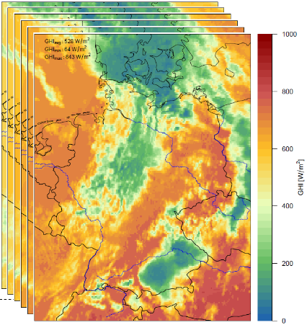
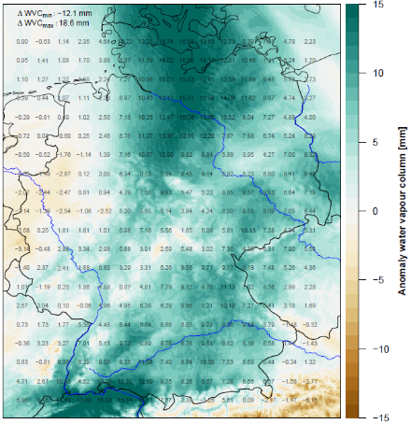
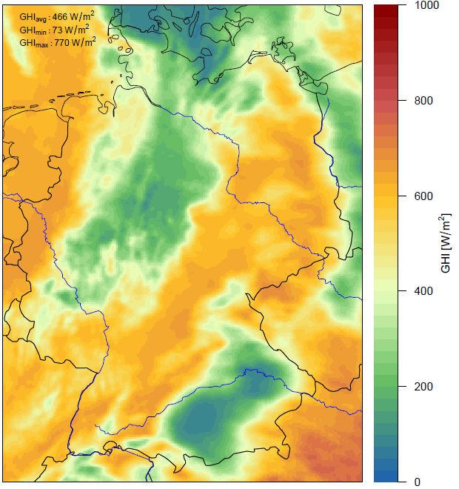
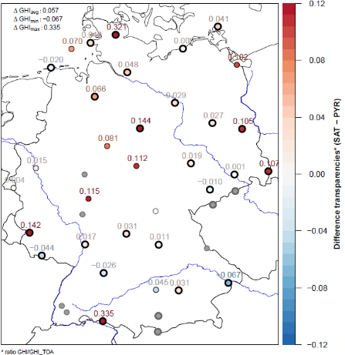
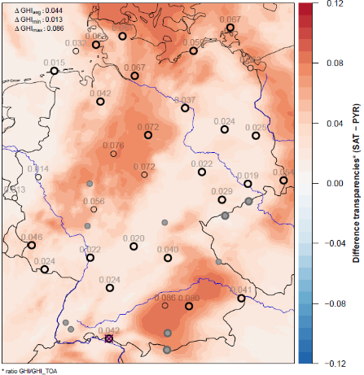
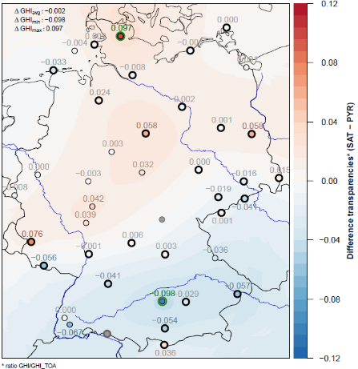
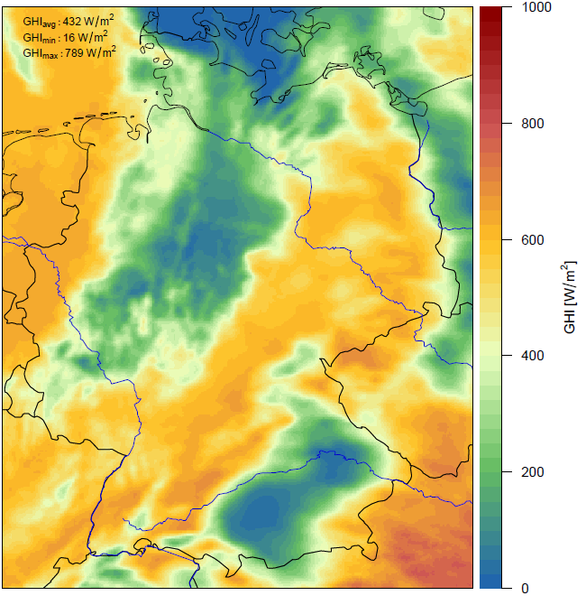
Processing Duett GHI
GHI_{sat} 1-min →
GHI_{sat} 1-h mean
H₂O-Col. ICON-D2
1-h mean → anomaly
GHI_{sat} 1-h mean
corrected
GHI_{sat} 15-min
pre-processed
Optical Flow
Correction
water vapour
GHI_{sat/cor} – GHI_{PYR}
normalized
GHI_{sat/cor} – GHI_{PYR}
regression model
resid. bias GHI_{sat}
interpolated
GHI_{duett} 1-h mean
Regression
Interpolation
Calculation
Product GHI Duett

Slide 4
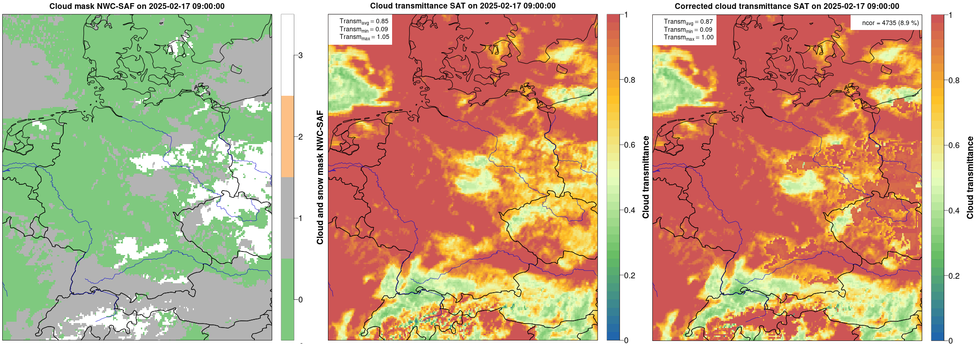
Pre-processing step: correction for clear-sky + snow-cover
with clear sky and snow at the surface identified as cloud by SAT algorithm → radiation highly underestimated
basis for correction: cloud mask data by NWC-SAF (https://www.nwcsaf.org/cma_v2025_msg)

Slide 5
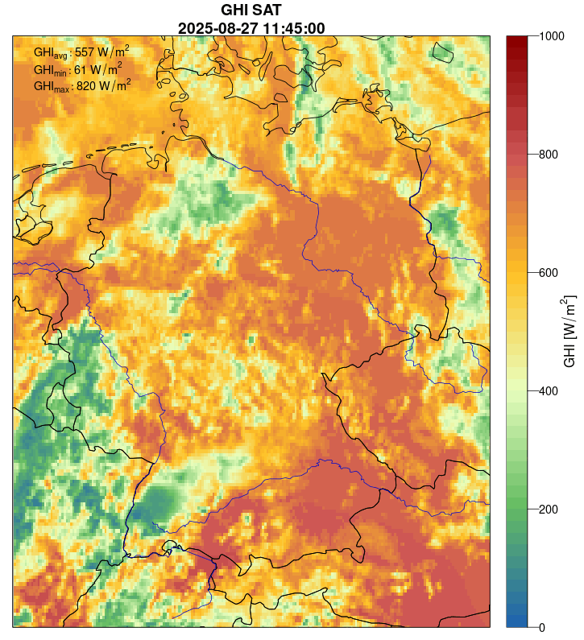
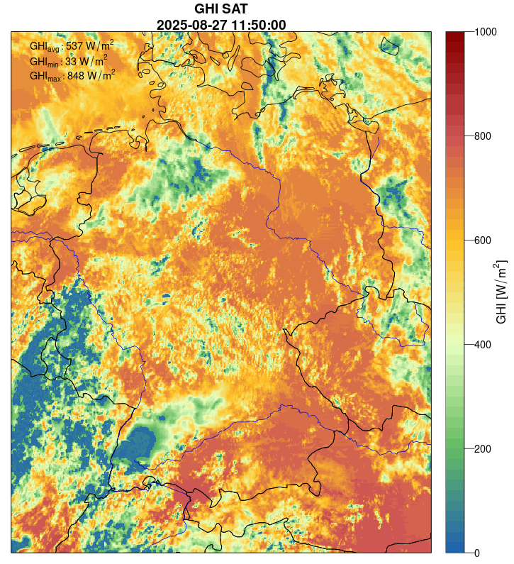
Step 1: Optical flow for time aggregation
enables a virtual resolution of 1-min
more precise data aggregation over 1-hour
aggregated for synoptic hour ending at HH:50
interpolated to 2 km Lambert-Conformal Conic (LCC) grid
result SEVIRI within 15 min
result FCI within 10 min

Slide 6
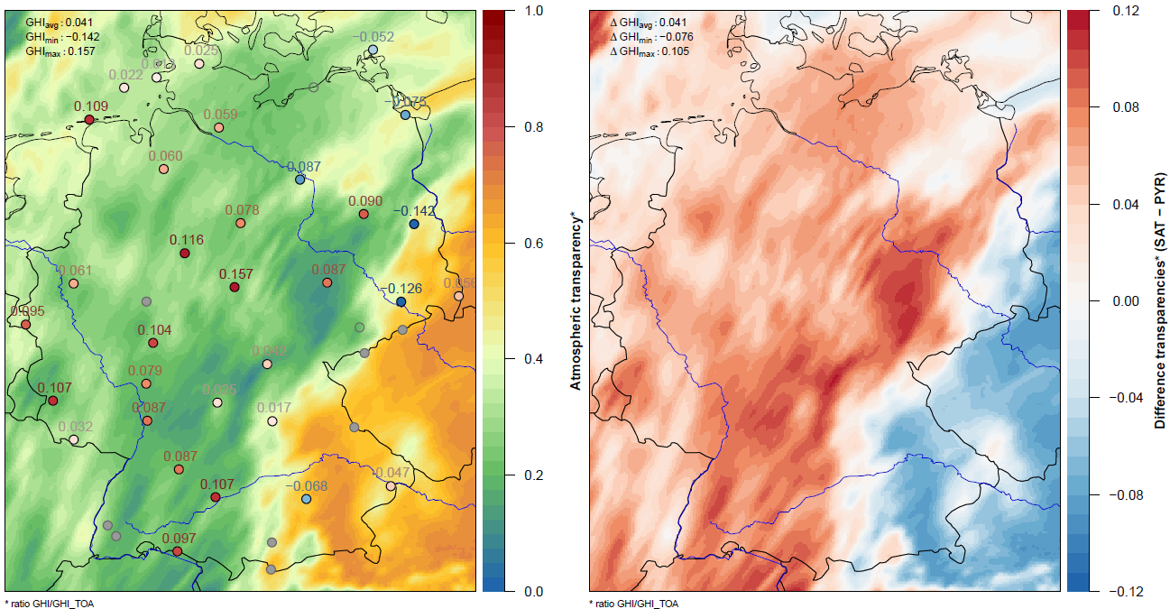
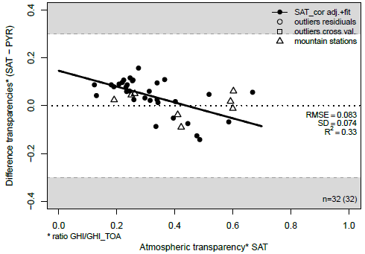
Step 3: Regression step → reduce systematic deviations
typically clouds optically too thin in SAT
such cases covered by regression with normal. GHI SAT as predictor
near. neighbour comparison SAT-PYR
if no correlation: simple global bias correction instead

Slide 7
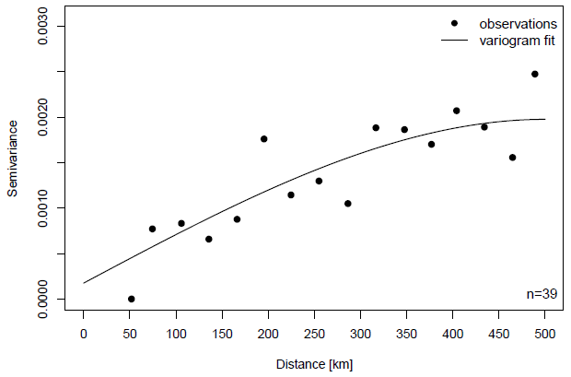
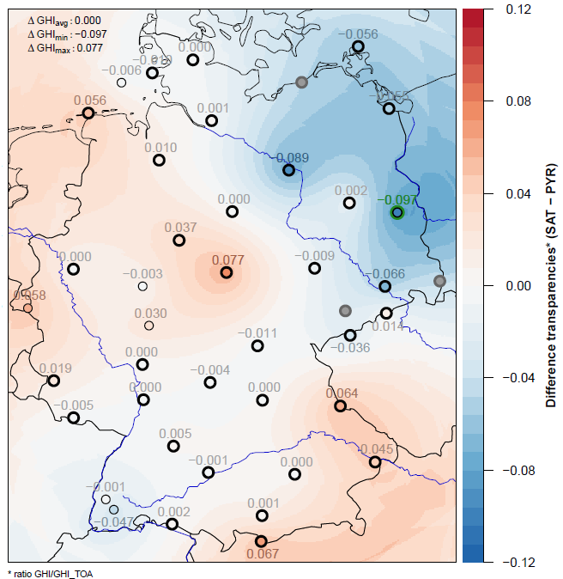
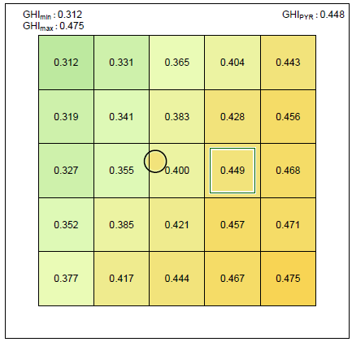
Step 4: Interpolation of residual ‚local‘ bias
comparison point vs. grid data
errors by representativeness,
parallax- and cloud shadow effects
strategy: choose best instead of near. neighbour within 25 grid cells
variogram model of residual local bias (w/o data pairs in mountains)
Ordinary Kriging → residual data field
10 km
data point: station measurement
at Hohenpeissenberg
10 km

Slide 8
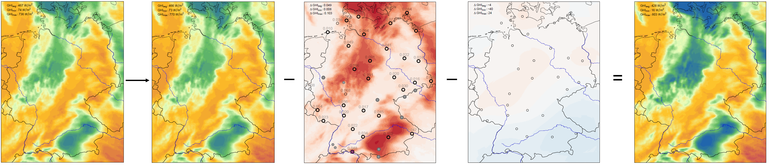
Overview of merging arithmetic GHI
GHI SAT 1 h GHI SAT 1 h Regr. model bias interp. local residuals GHI Duett 1 h
(snow-corrected) (+H₂O-corrected)

Slide 9
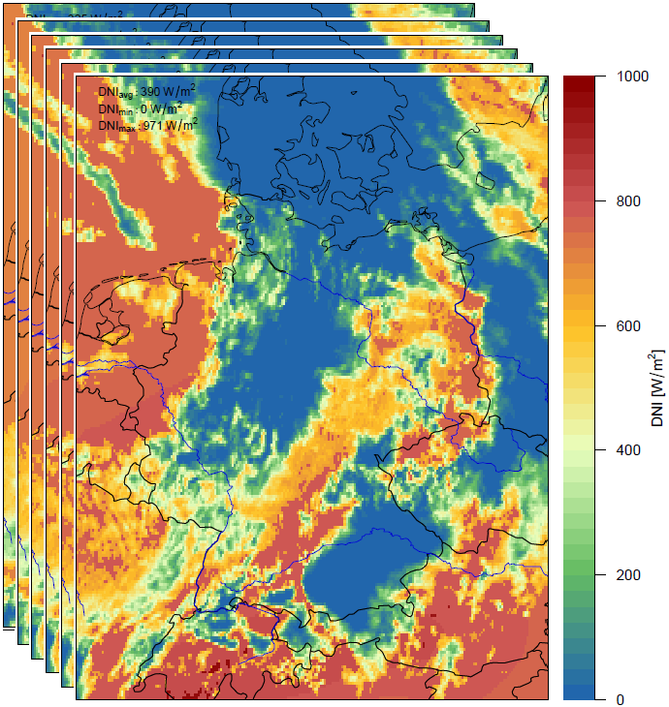
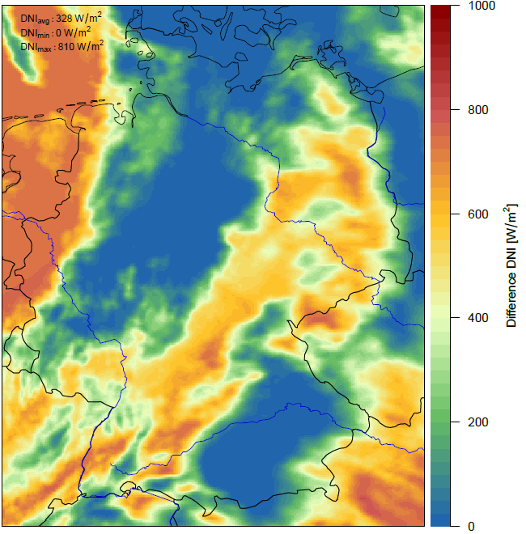
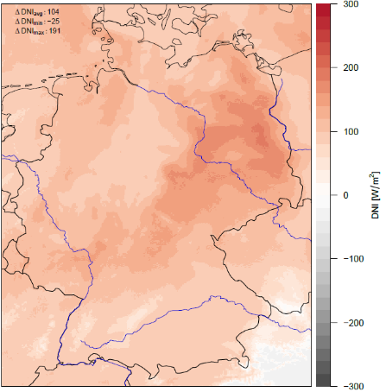
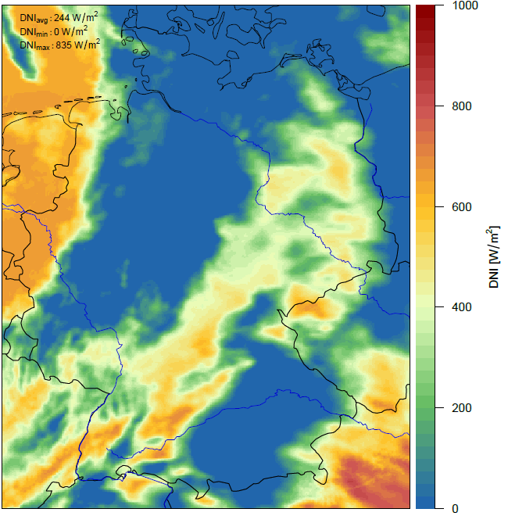
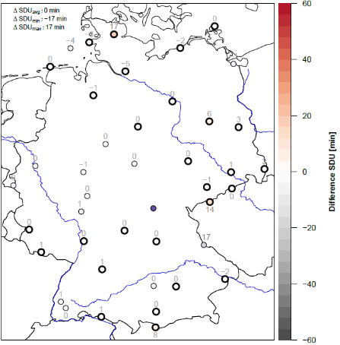
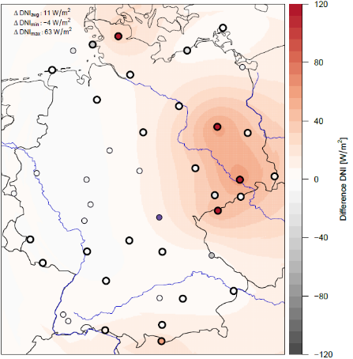
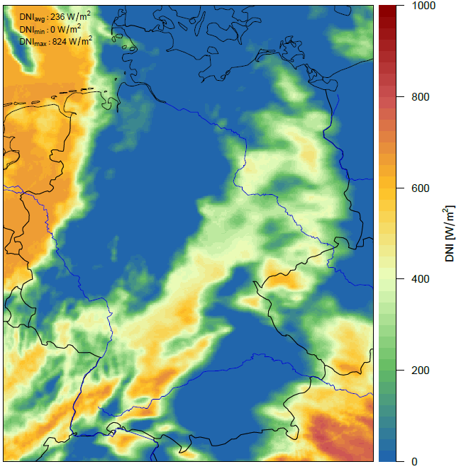
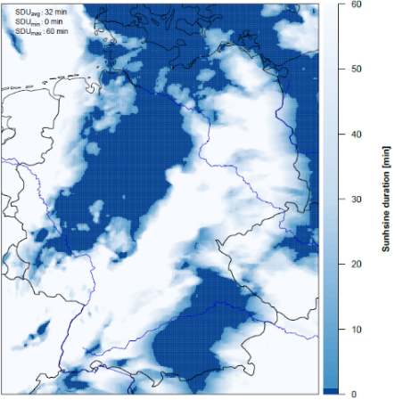
Processing Duett sunshine duration (SDU)
DNI_{SAT} 1-min →
SDU_{sat}
‚global‘ bias
DNI_{sat}
DNI_{sat} 1-min
bias-corrected
DNI_{sat}15-min pre-processed
Optical Flow
Estimation of
‚global‘ bias
Correction of
‚global‘ bias
SDU_{sat/cor} – SDU_{pyr}
→ ‚local‘ bias DNI_{sat}
resid. bias DNI_{sat}
interpolated
DNI_{sat} 1-min
bias-corrected v2
SDU_{duett} 1h
Interpolation of
residual bias
Correction of
residual bias
Calculation SDU
DNI ≥ 120 W/m²

Slide 10
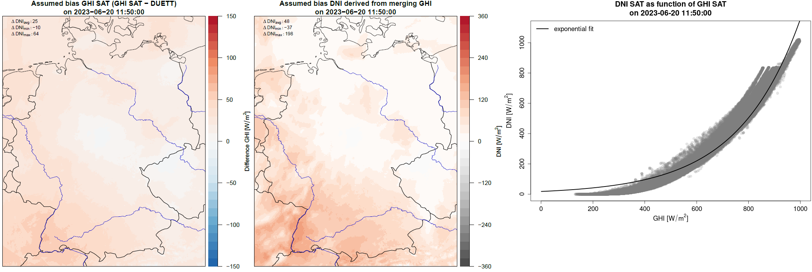
Processing DUETT SDU
Correction ‚global‘ Bias part 1 (translated from Bias GHI)

Slide 11
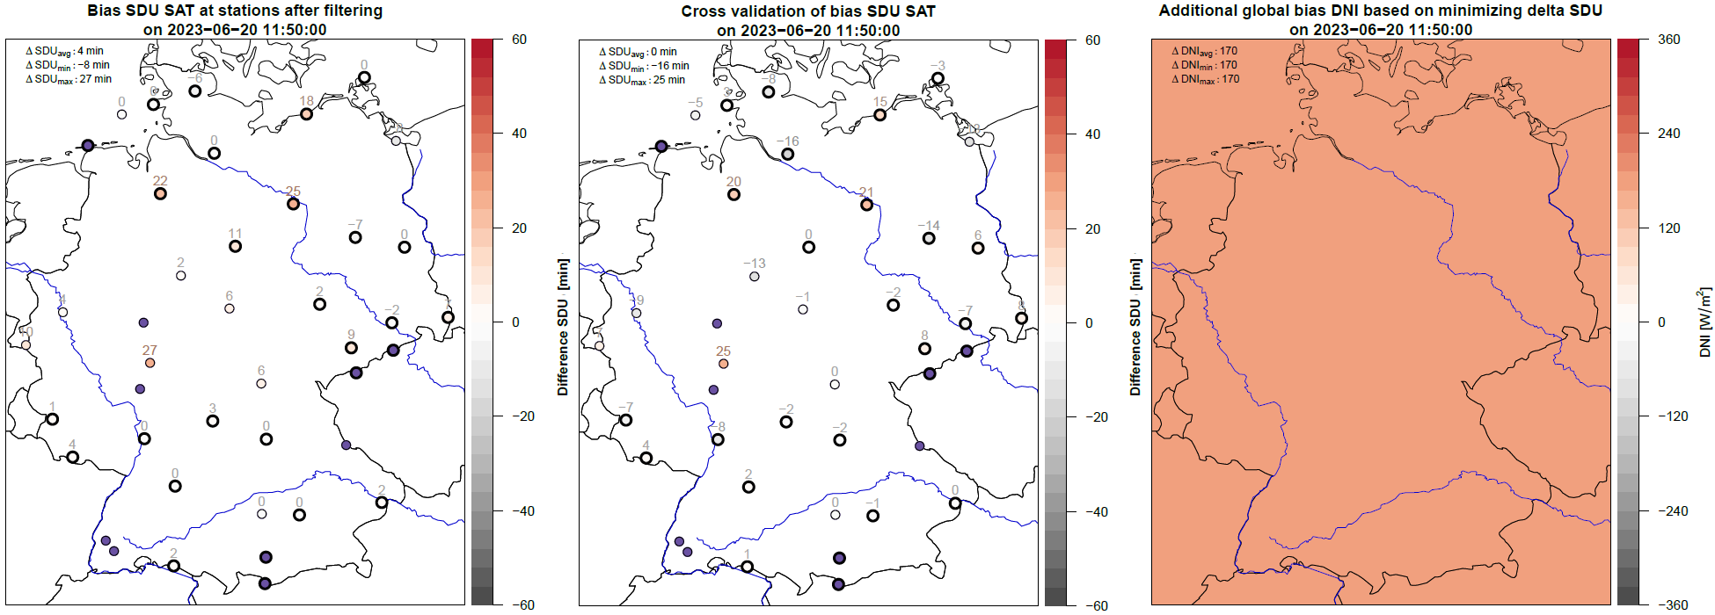
Processing DUETT SDU
Correction ‚global‘ Bias part 2 (Δ_{SDU} at stations on average → zero)

Slide 12
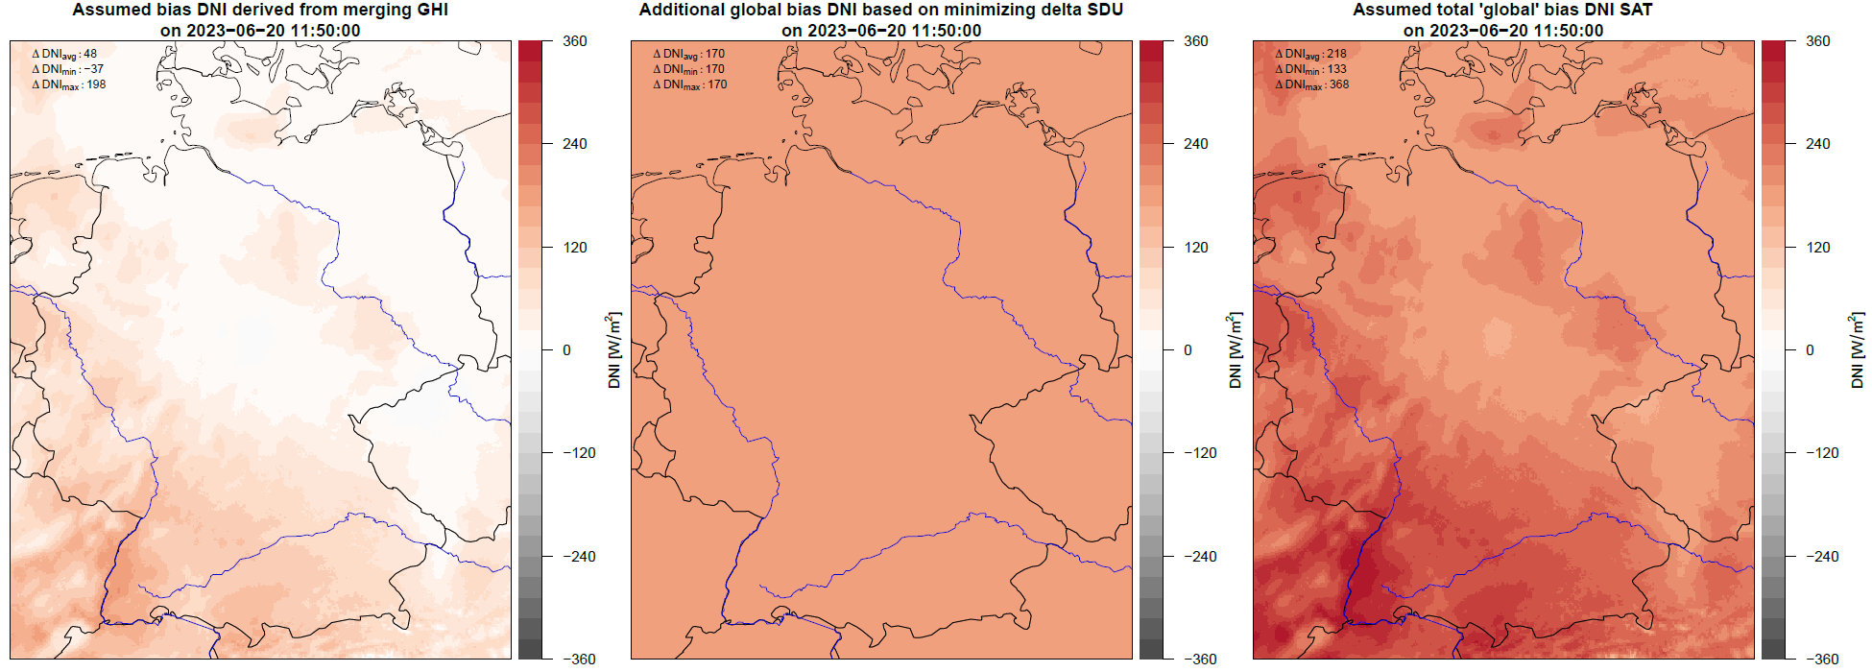
Processing DUETT SDU
Correction ‚global‘ Bias: total Bias

Slide 13
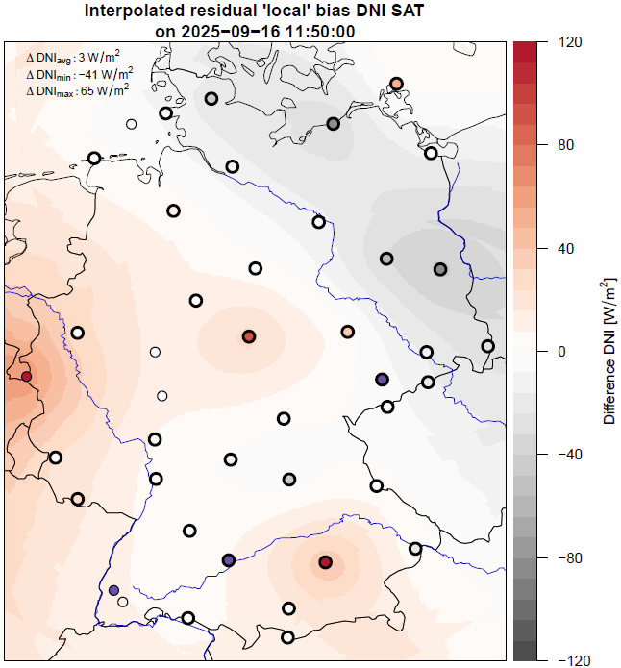
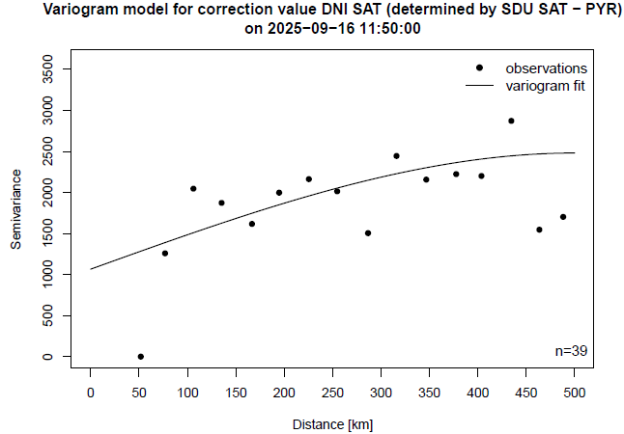
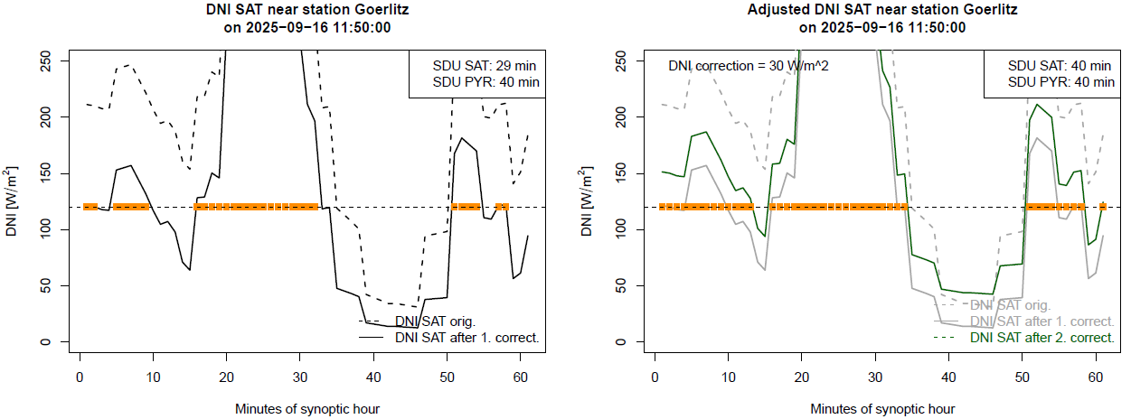
Processing DUETT SDU
Interpolation residual ‚local‘ Bias

Slide 14
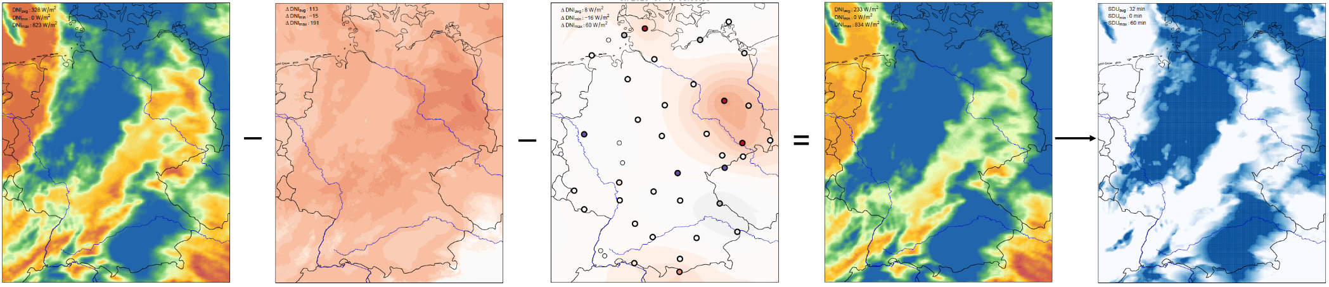
Overview of merging arithmetic for SDU
DNI SAT 1 min global Bias ‚local‘ Bias interp. DNI Duett 1min SDU Duett 1h
(snow-corrected) (to max -60%)

Slide 15
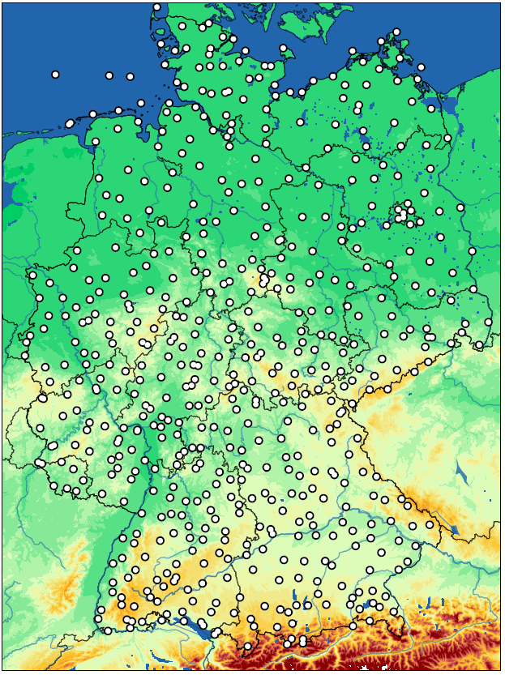
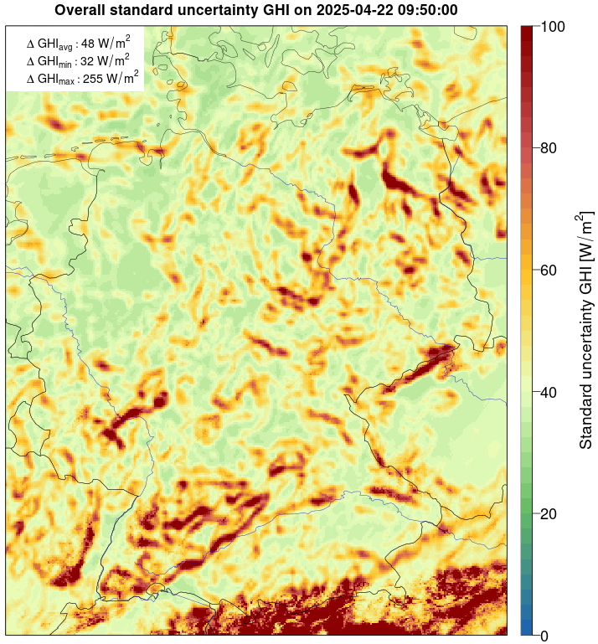
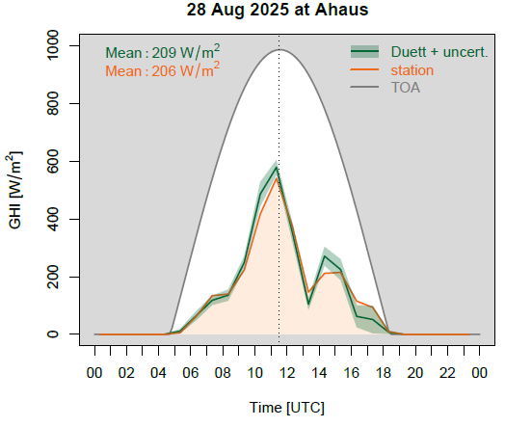
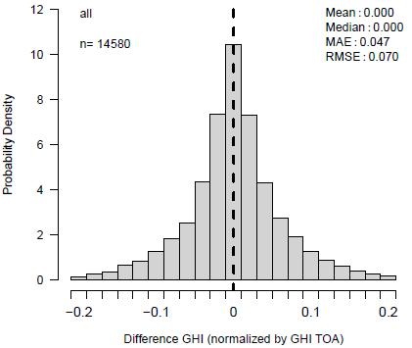
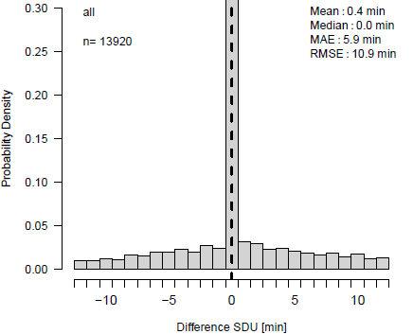
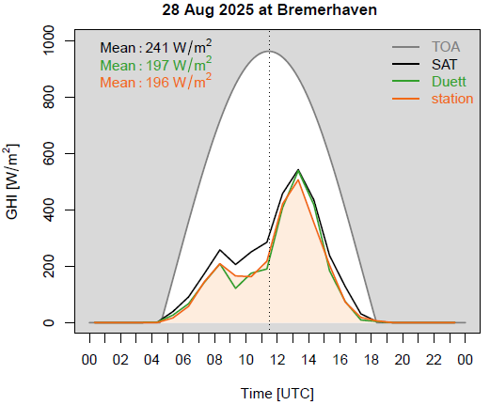
Pseudo station data Uncertainties
at 576 locations
with correction of shadowing by mountains
estimating effects from
  interpolation
  geometry
  topography
Validation Cross Validation
MAE GHI: ~5% of GHI_{TOA}
MAE abs.: 15 – 40 W/m²
MAE SDU: 5-6 min

Slide 16
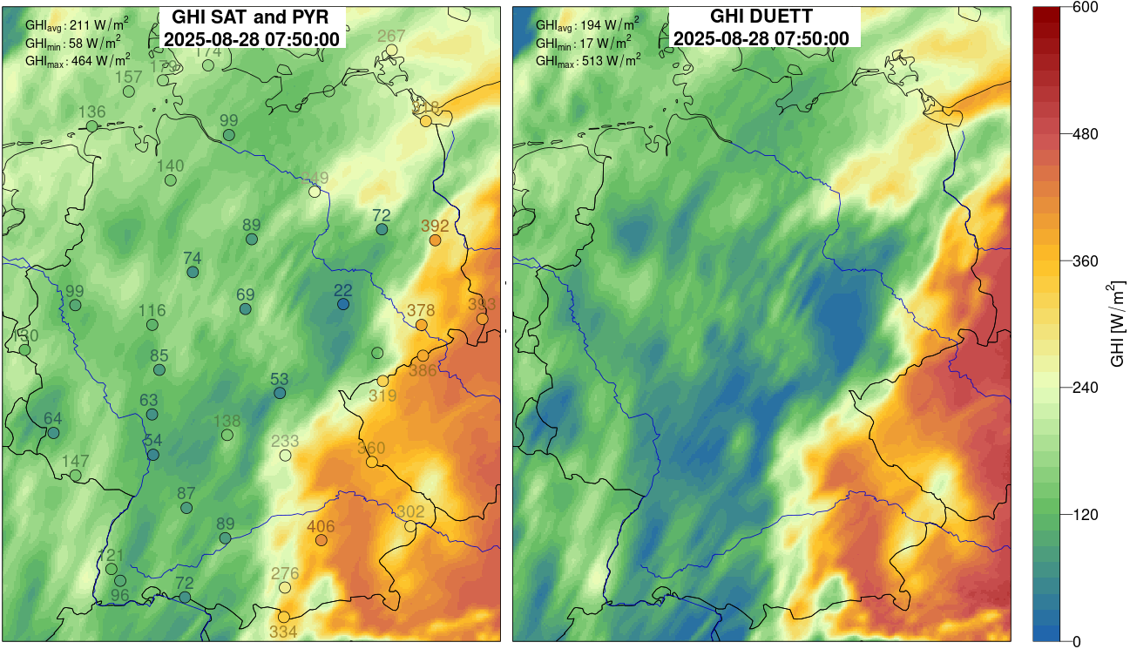
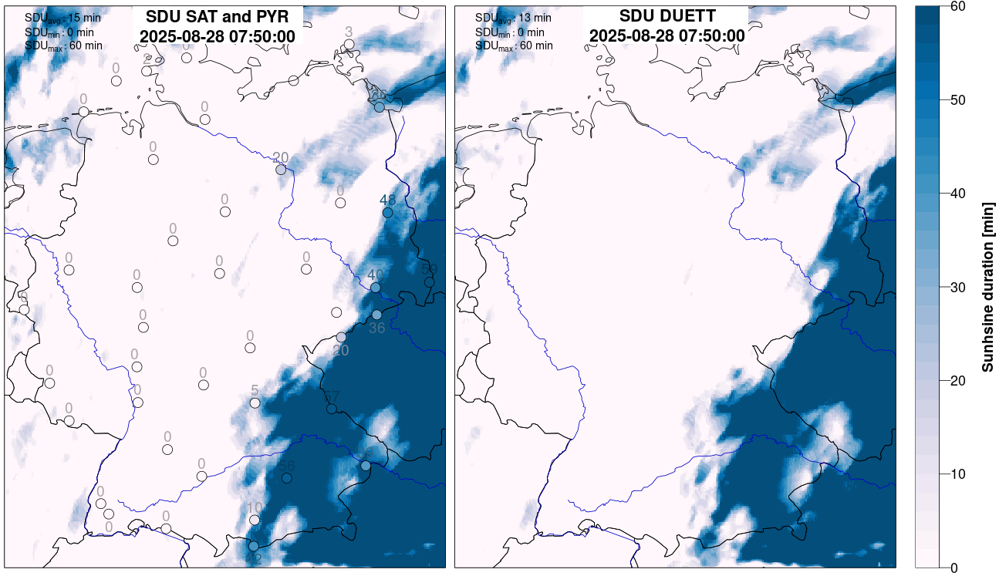
Summary and Outlook
combined hourly gridded radiation data for Germany since Aug 2022 / Open Data (CDC): since Jan 2024
www.dwd.de/duett
global horinzontal irradiance and sunshine duration (2 km resolution) + std. uncertainty in near real-time
pseudo station data at 576 locations with correction of shadowing since Oct 2023 / Open Data: Apr 2024
new processing with FCI data (1 km) ready and will replace SEVIRI-based data in June 2026
additional parameter: diffuse radiation ready, to be published in near future
correction of geometric errors (parallax and cloud shadowing) planned in autumn 2026
fotografiert

Slide 17
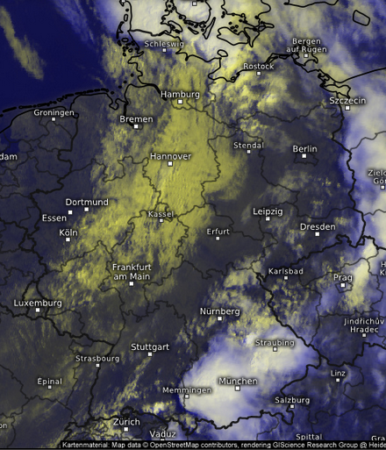

Satellite Data (near real-time)
‚Heliosat‘ method
Basis: 0.6 μm channel
Reflectance as indicator for
cloud albedo (CAL)
Clear-sky radiation (GHI_{clr}) calculated with radiative transfer model
GHI = (1-CAL) ∙ GHI_{clr}
Müller et al., 2012: https://doi.org/10.3390/rs4030622
MSG - SEVIRI
MTG - FCI

Slide 18
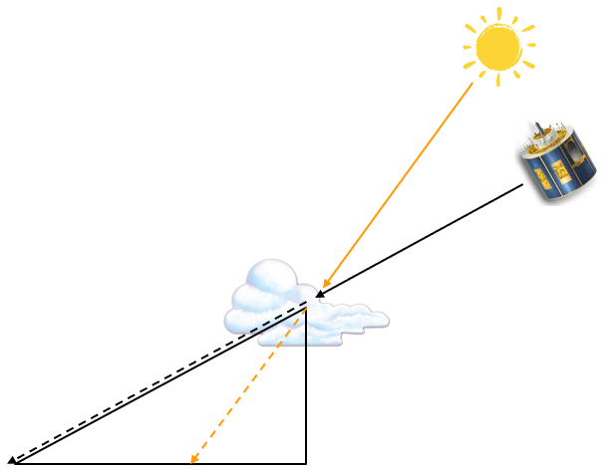
Satellite Data – geometric errors
Illustration of geometric errors in observation of clouds and radiation at surface from space
MTG - FCI

