Slide 1

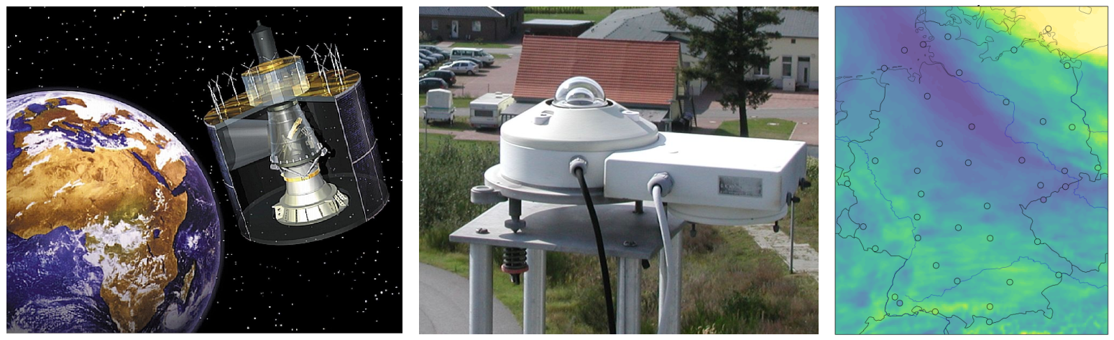
Operationally-generated hourly solar irradiance and sunshine duration using satellite observations and ground-based measurements (DUETT)
Jörg Trentmann, Sven Brinckmann

Slide 2
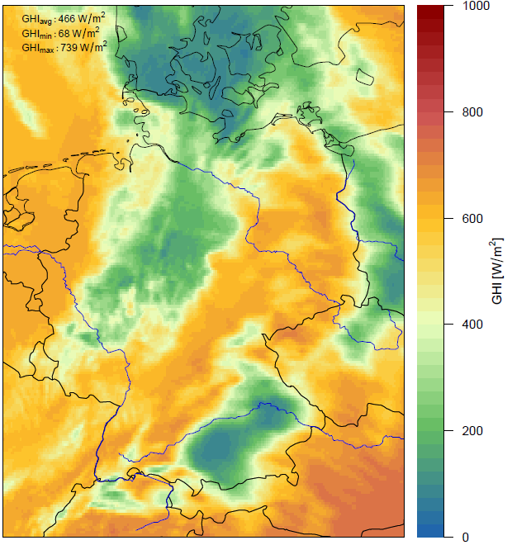
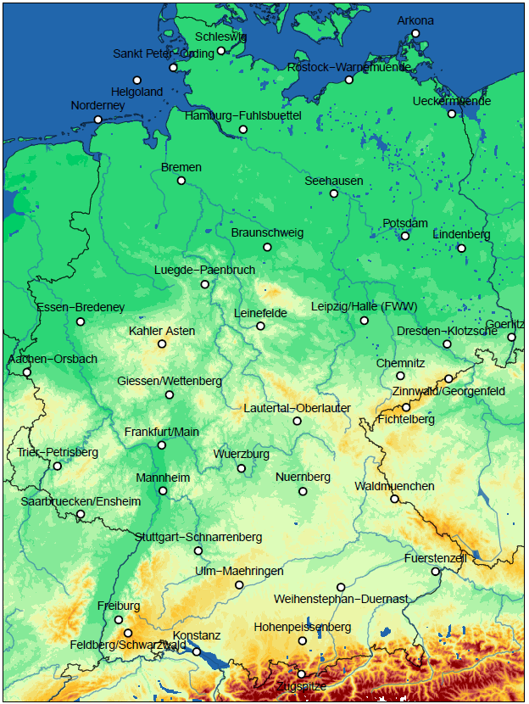
Motivation for DUETT
DWD is updating the acquisition of surface irradiance and sunshine duration data (current instrumentation no longer available)
Quality and reliability of satellite-based sunshine duration / surface irradiance data continously improved
Surface-based measurements at 42 locations with
high-quality instruments (2 pyranometer for global and diffuse radiation / sunshine duration)
Use of satellite data in addition to ground measurements
Combine both data soures to provide
  high-quality gridded data and
  time series data at pseudo-station locations

Slide 3
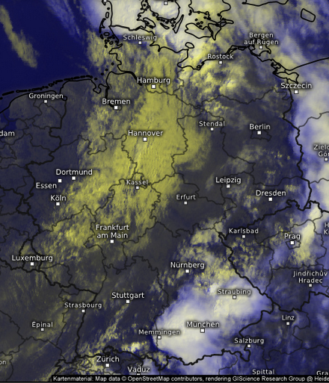
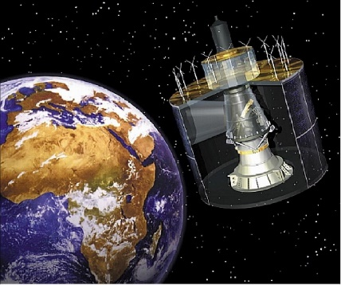
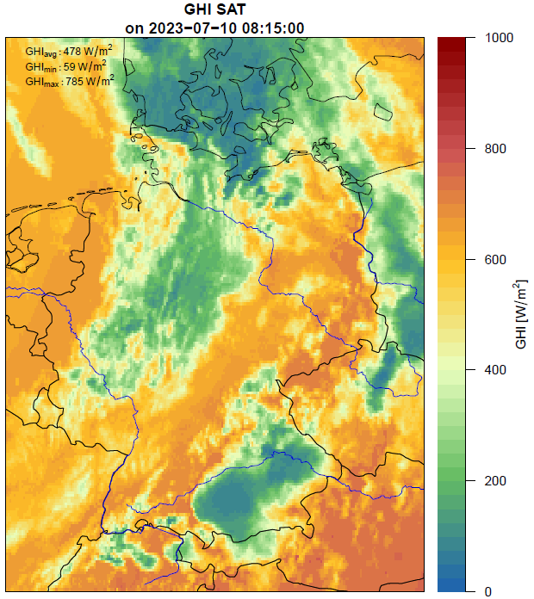
Satellite-based data
Heliosat-method
Based on Meteosat / SEVIRI visible channel
Retrieval of the effective cloud albedo, CAL, based on visible satellite reflectance, R:
  CAL = (R – R_{min}) / (R_{max} – R_{min})
Calculation of clear-sky surface irradiance, G_{clear}, using RTM (SPECMAGIC), assuming information on water vapor, aerosol, albedo
Estimation of surface irradiance, G:
    G = (1 – CAL) x G_{clear}
Operational processing at DWD:
  Global and direct radiation
Spatial / temporal resolution: 15 min, 0.05° (approx. 5 x 5 km)
openly available approx. 10 min after the observation
https://opendata.dwd.de/weather/satellite/radiation

Slide 4
DUETT processing steps: Surface irradiance
Correction for clear-sky situations over snow-covered surfaces
Aggregation of the instantaneous (15 min) satellite measurements to hourly averages
Adjustment of water vapor using ICON-D2 information
Regression modeling to reduce systematic bias between satellite-based data and surface measurements
Interpolation of the remaining residual bias
Apply overall bias to the original hourly satellite-based data

Slide 5
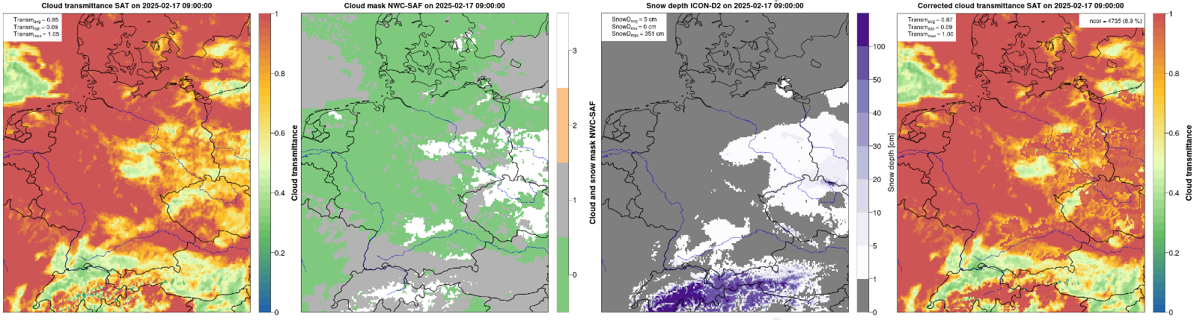
Correction for clear-sky situations over snow-covered surfaces
Original
clear-sky / snow mask
(NWC-SAF)
snow mask
(ICON-D2)
Corrected

Slide 6
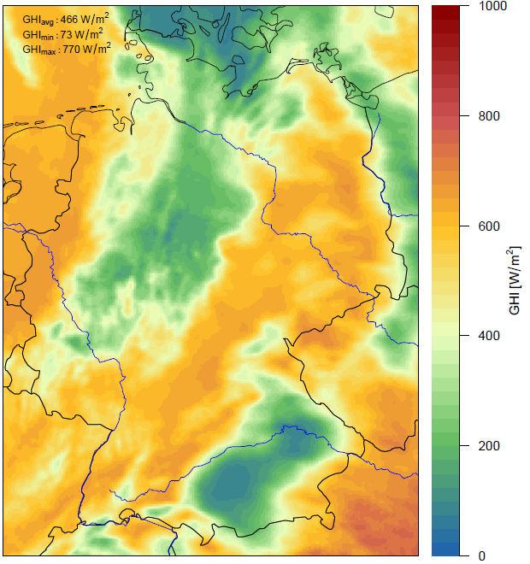
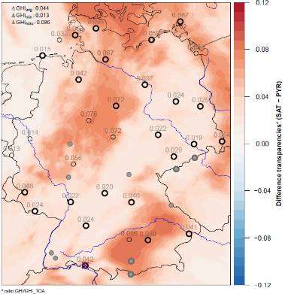
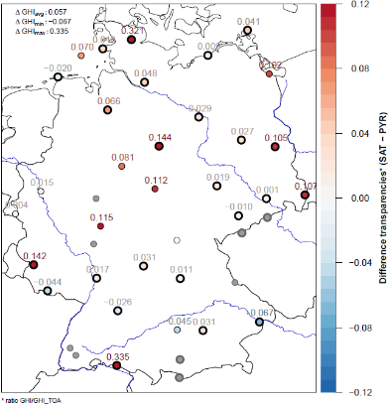
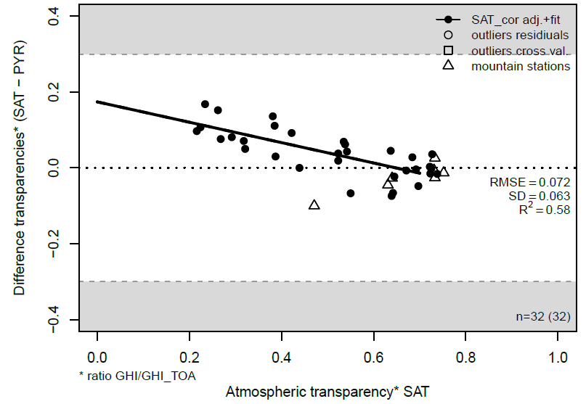
Regression modeling to reduce systematic bias between satellite-based data and surface measurements
Satellite data tends to overestimate surface radiation under cloudy sky situation and to underestimate radiation under clear sky situations
Derive correlation between cloud transmittance and bias, and apply correction factor based on cloud transmission
low high radiation

Slide 7
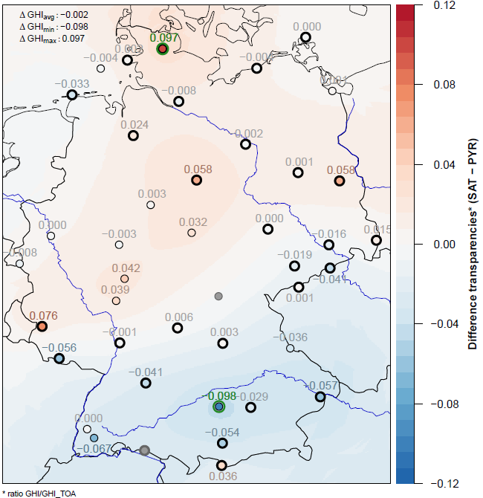
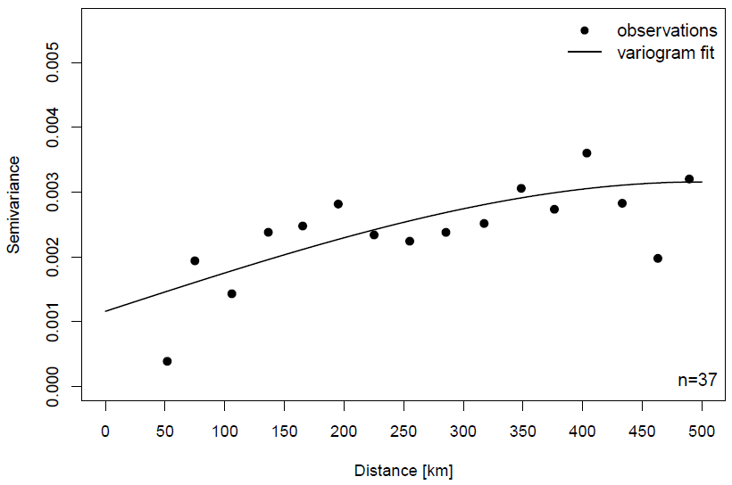
Spatial interpolation of the residual bias
Derive variogram of the residual bias
Spatial interpolation based on ordinary kriging

Slide 8
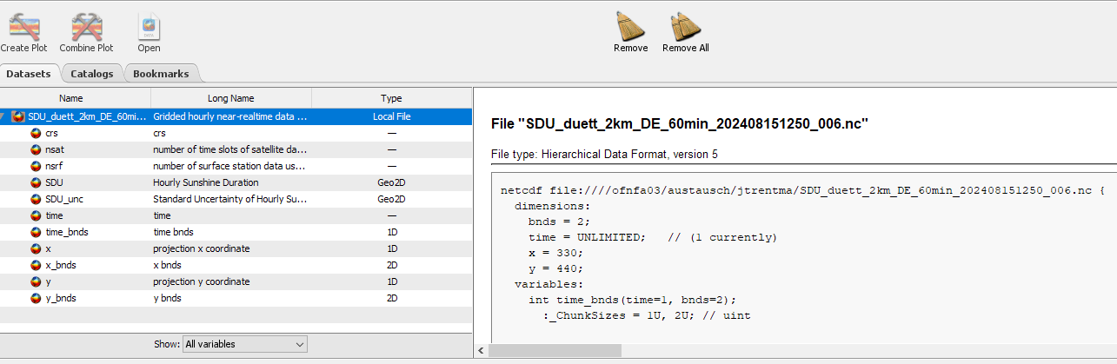
DUETT processing steps: Surface irradiance
Correction for clear-sky situations over snow-covered surfaces
Aggregation of the instantaneous (15 min) satellite measurements to hourly averages
Adjustment of water vapor using ICON-D2 information
Regression modeling to reduce systematic bias between satellite-based data and surface measurements
Interpolation of the remaining residual bias
Apply overall bias to the original hourly satellite-based data
Operational processing at DWD, every hour:
  Global radiation and sunshine duration for ‚synoptic hour‘,
  i.e., HH:50 to (HH+1):50
Spatial / temporal resolution: 60 min, 2 x 2 km (EPSG 3034)
netCDF-Format
openly available approx. 10 min after the full hour: https://opendata.dwd.de/climate_environment/CDC/grids_germany/hourly/duett/

Slide 9
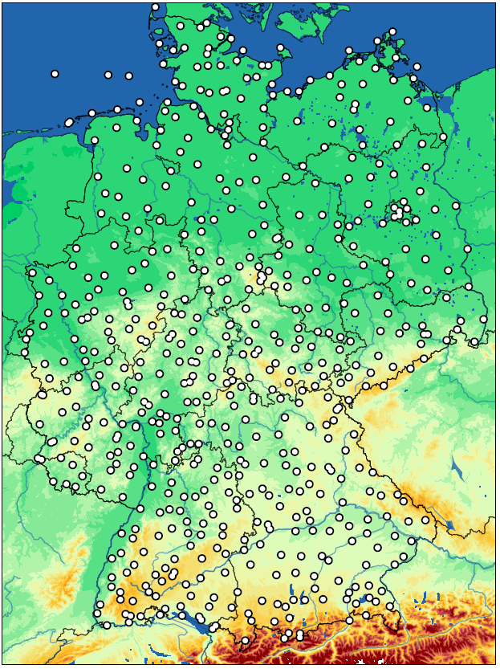
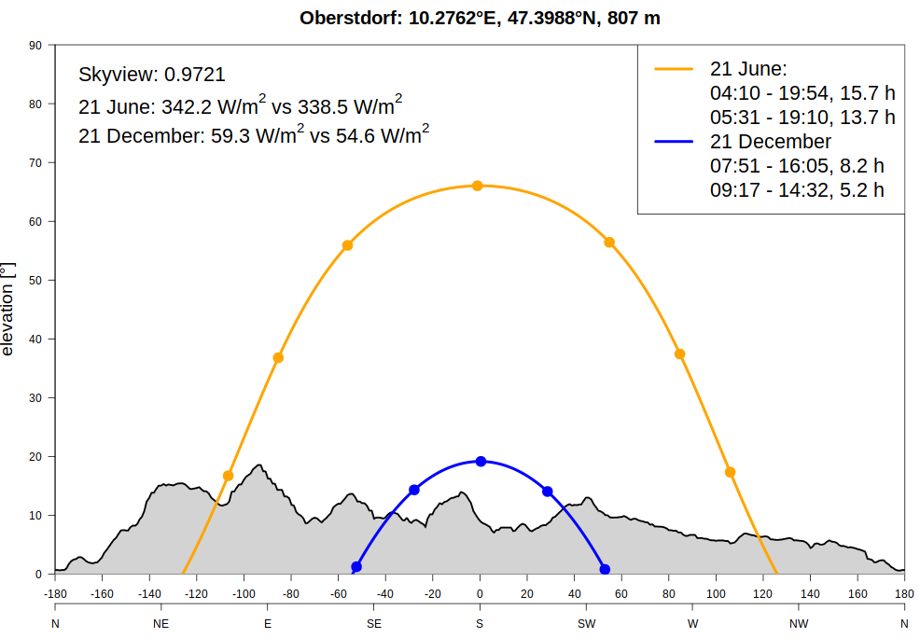
DUETT pseudo-station data
DUETT data provided for 576 so-called pseudo-stations
  nearest-neighbor extraction
  incl. terrain shadowing
Openly available
  individual hours: csv, bufr; available at HH:10:
  https://opendata.dwd.de/weather/weather_reports/derived
  time series: csv; available at +1 day:
  https://opendata.dwd.de/climate_environment/CDC/derived_germany/climate/hourly/duett
DUETT Data available since April 2024
Data for pseudo-station appear to be widely used, in particular due to the removal of the sunshine duration instrumentation (197 in Jan 2024, 108 in May 2025)

Slide 10
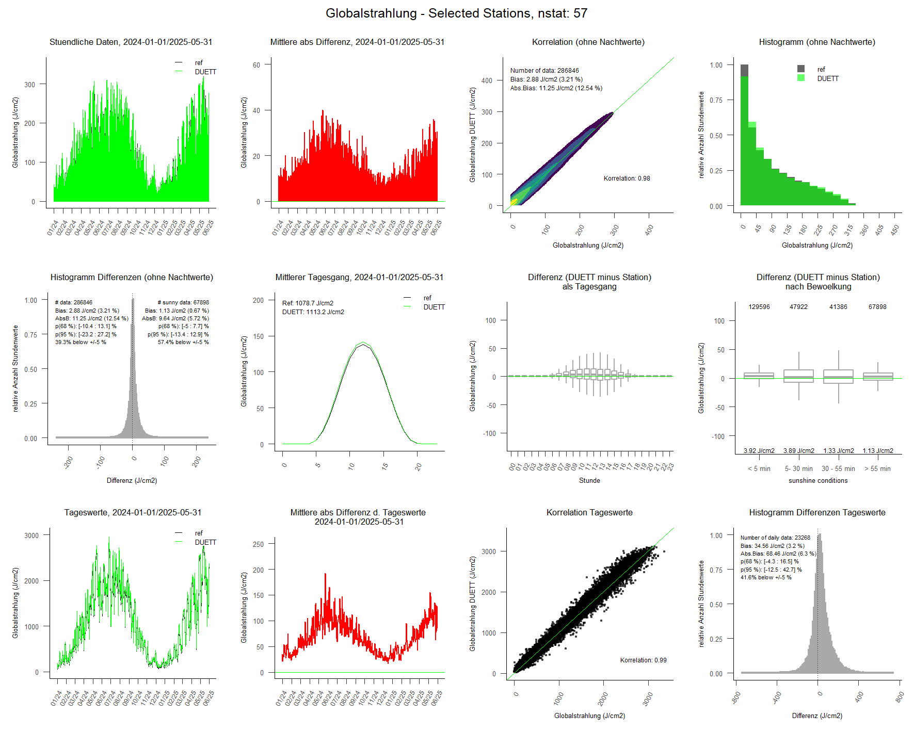
Evaluation: Surface Irradiance
Hourly surface radiation
57 stations:
  independent
  below 500 m
01.01.2024 to 31.05.2025

Slide 11
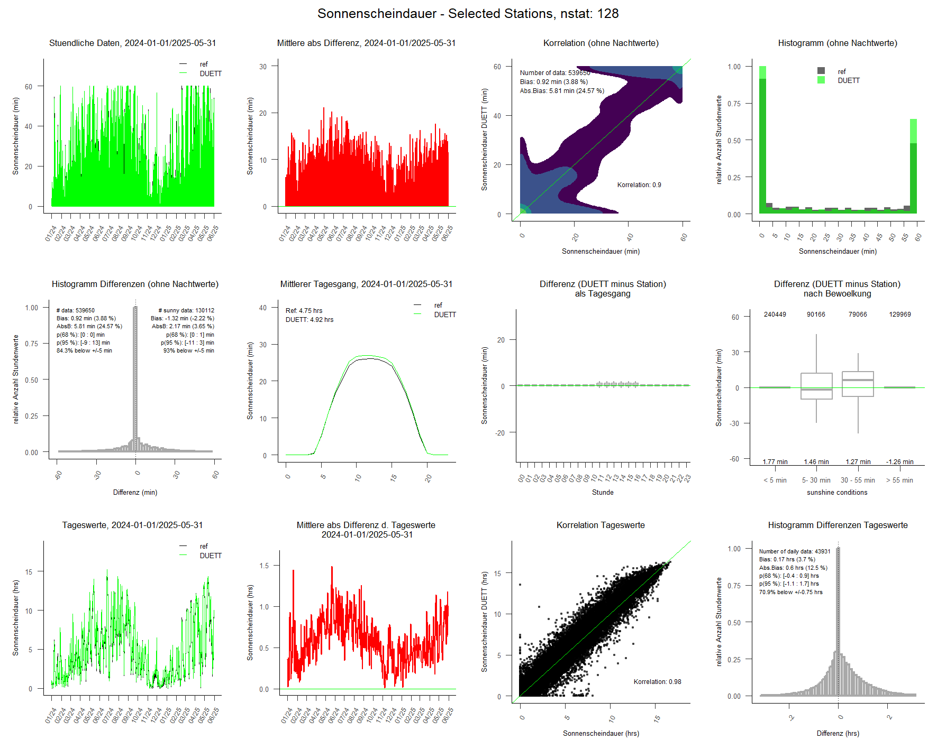
Evaluation: Sunshine Duration
Hourly sunshine duration
128 stations:
  independent
  below 500 m
01.01.2024 to 31.05.2025

Slide 12
Evaluation: Sunshine Duration
Cloudy situations
  zero bias for most observations
  small overestimation (on average)
Sunny situations
  zero bias for most observations
  small underestimation (on average)
Partly cloudy
  larger spread in bias
cloudy
clear-sky

Slide 13
Evaluation: Sunshine Duration
Frequency distribution
  DUETT data include too many minimum (0 min) and maximum (60 min) values of sunshine duration
  Too few sunshine duration values between 5 and 55 min in the DUETT data
cloudy
clear-sky

Slide 14
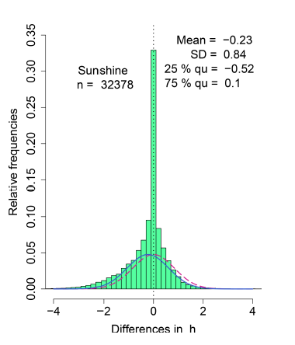
Daily Sunshine Duration
Evaluierung DUETT Daten, 1.1.2024 – 31.05.25
128 independent stations, below 500 m
Automatic sensor minus Campell-Stokes
Daily Sums
Mean absolute difference
Correlation
Histogram of the differences
Hannak et al., 2019

Slide 15
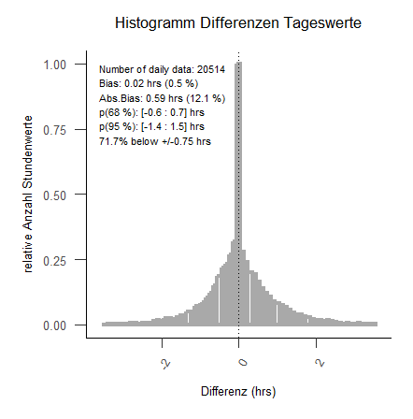
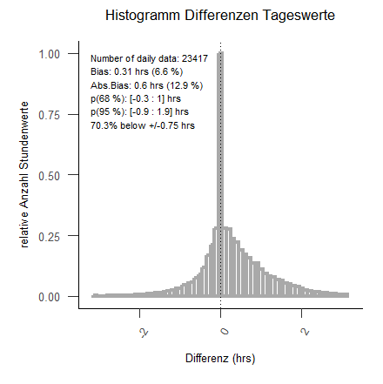
Evaluation: Sunshine Duration (SONIe v SCAPP)
SONIe vs SCAPP
  Two instruments (similar technique) are currently (still) in place to measure sunshine duration:
  SONIe + Scapp
  Excellent correspondence of the DUETT data with SONIe measurements, overestimation of DUETT data for stations with SCAPP
  Systematic difference between SONIe and SCAPP currently under investigation
SONIe
SCAPP
bias: 0.02 hrs / 0.5 %
bias: 0.31 hrs / 6.6 %

Slide 16
Problematic situations
Cloud shadowing
Small-scale cloudiness
???

Slide 17
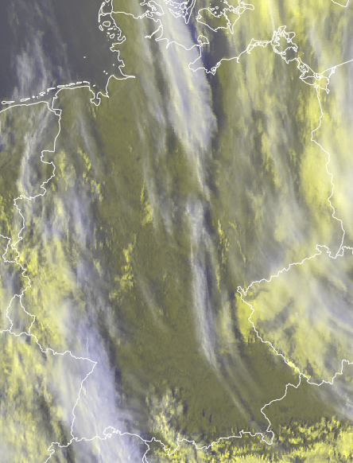
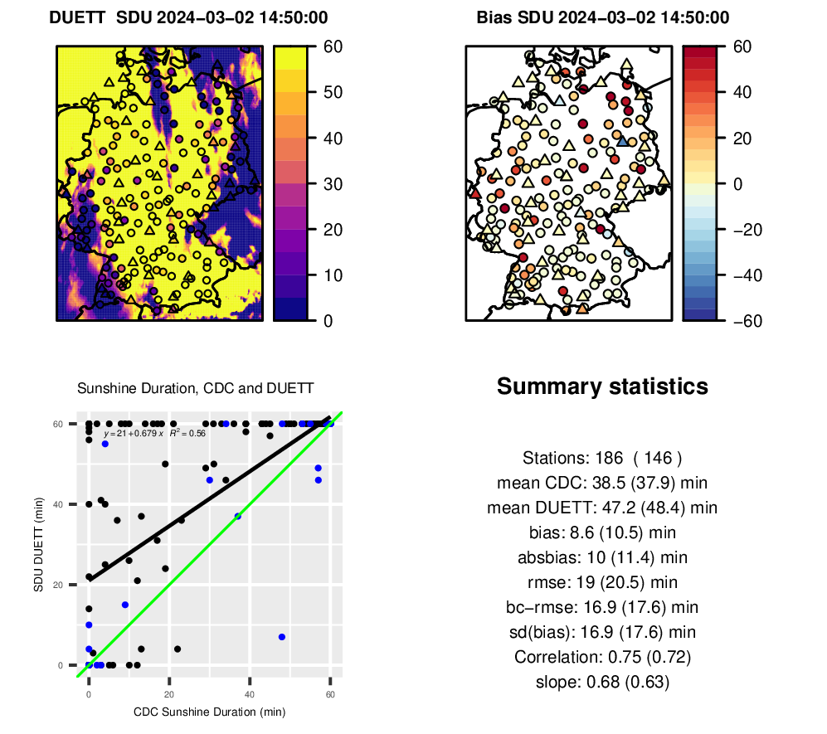
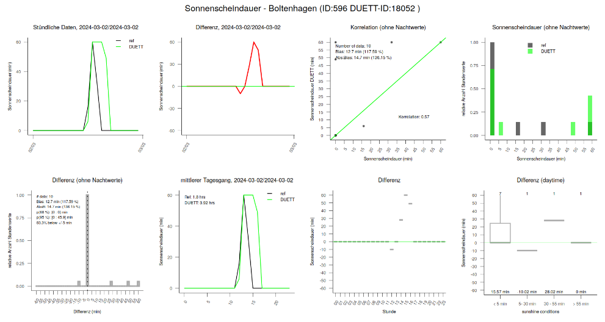
Cloud Shadows
2 March 2024, 14:50 UTC
3D-cloud effects by clouds not considered
Particular relevant at low sun
Improvements might be possible by using information on cloud height
2 March 2024, 14:45 UTC

Slide 18
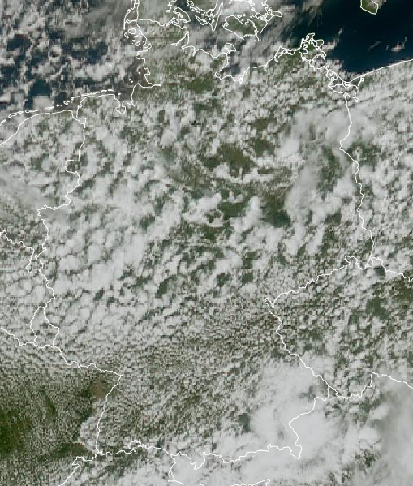
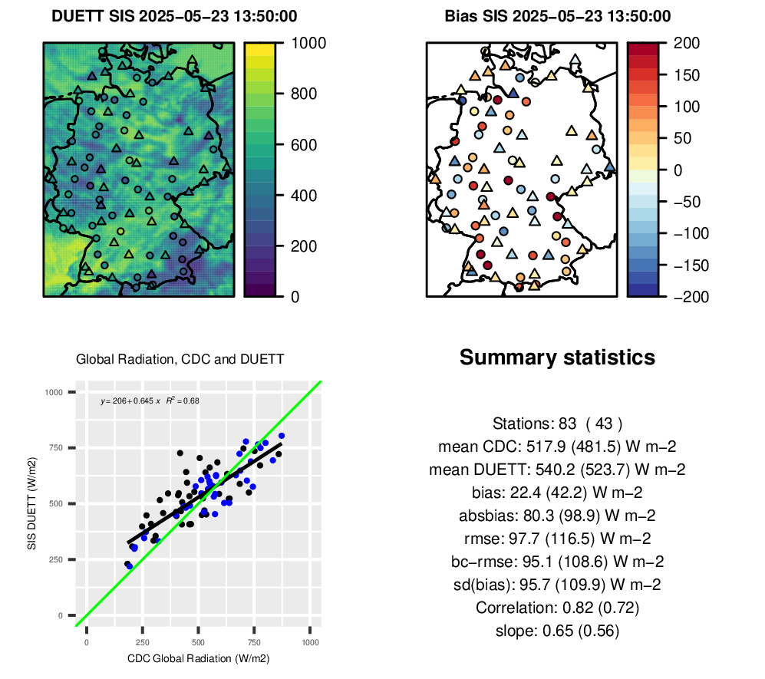
Small-scale cloudiness
23 May 2025
  Difficult situation for satellite data
  Improvement by using MTG-FCI seems possible (operational implementation in Fall 2025)
23. May 2025, 13:50 UTC

Slide 19
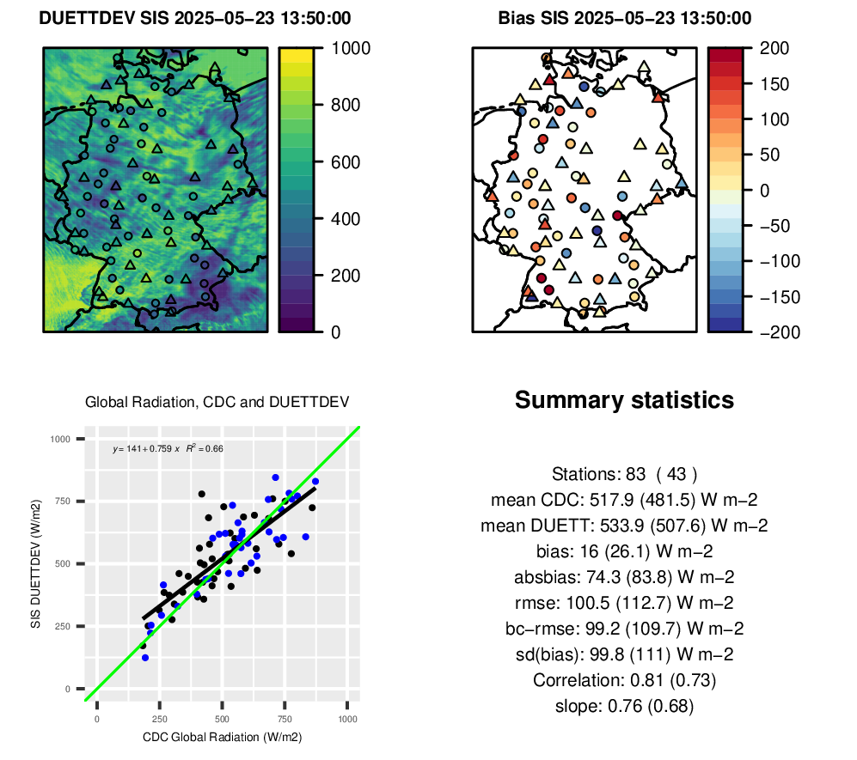
Small-scale cloudiness (MTG-FCI)
23 May 2025
23 May 2025, 13:50 UTC

Slide 20
Next steps
Integration of data from the new Meteosat satellite, MTG, instrument FCI:
  Higher spatial resolution: approx. 0.015°
  Higher temporal resolution: 10 min
  DUETT data will be provided at 1 km spatial resolution (EPSG 3035)
Extent the spatial coverage of the DUETT data
  Additional surface radiation / sunshine data from neighboring countries needed
Include diffuse radiation into the processing
….

Slide 21


Summary
DUETT provides hourly data of sunshine duration and global radiation:
  Gridded (2 km, ncdf-Format)
  576 virtual stationen (csv / bufr)
Difference to surface measurements less than 5 min for more than 80 % of the hourly data (almost 40% less than 5 % for surface irradiance)
Some larger differences in sunshine duration for intermediate values between 5 an 55 min.
There are situations with larger / systematic differences.
Transition to data from the new satellite instrument (FCI) will allow a higher spatial resolution (Fall 2025)!

