Slide 1
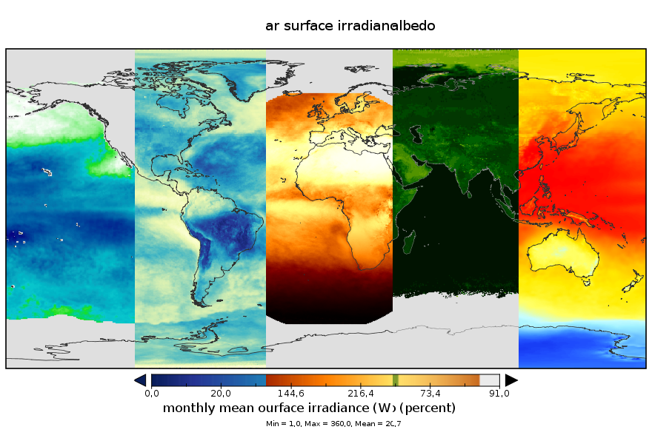
25 years of a sustained Generation of Satellite-Based Climate Data Records by CM SAF
J. Trentmann, R. Hollmann, M. Schröder, N. Selbach and the CM SAF team
Notes:
Welcome, opp to intro CM SAF, pleasure to talk in from of SAFs and both WG

Slide 2
Overview
Introduction to CM SAF
Overview of available CM SAF data records
A few details on
  Reprocessed and operationally extended data
  Recent data record releases
  Example application
  Climate normal and anomaly service from CM SAF
Conclusions

Slide 3






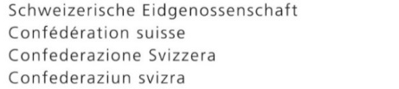





CM SAF
EUMETSAT Satellite Application Facility on Climate Monitoring (CM SAF)
https://www.cmsaf.eu
Deutscher Wetterdienst
Swedish Meteorological and Hydrological Institute
Royal Meteorological Institute of Belgium
Finnish Meteorological Institute
25
1999 - 2024
CM SAF Member States
Location of Partner NMHSs
Met Office, United Kingdom
Centre National de la recherche scientifique

Slide 4
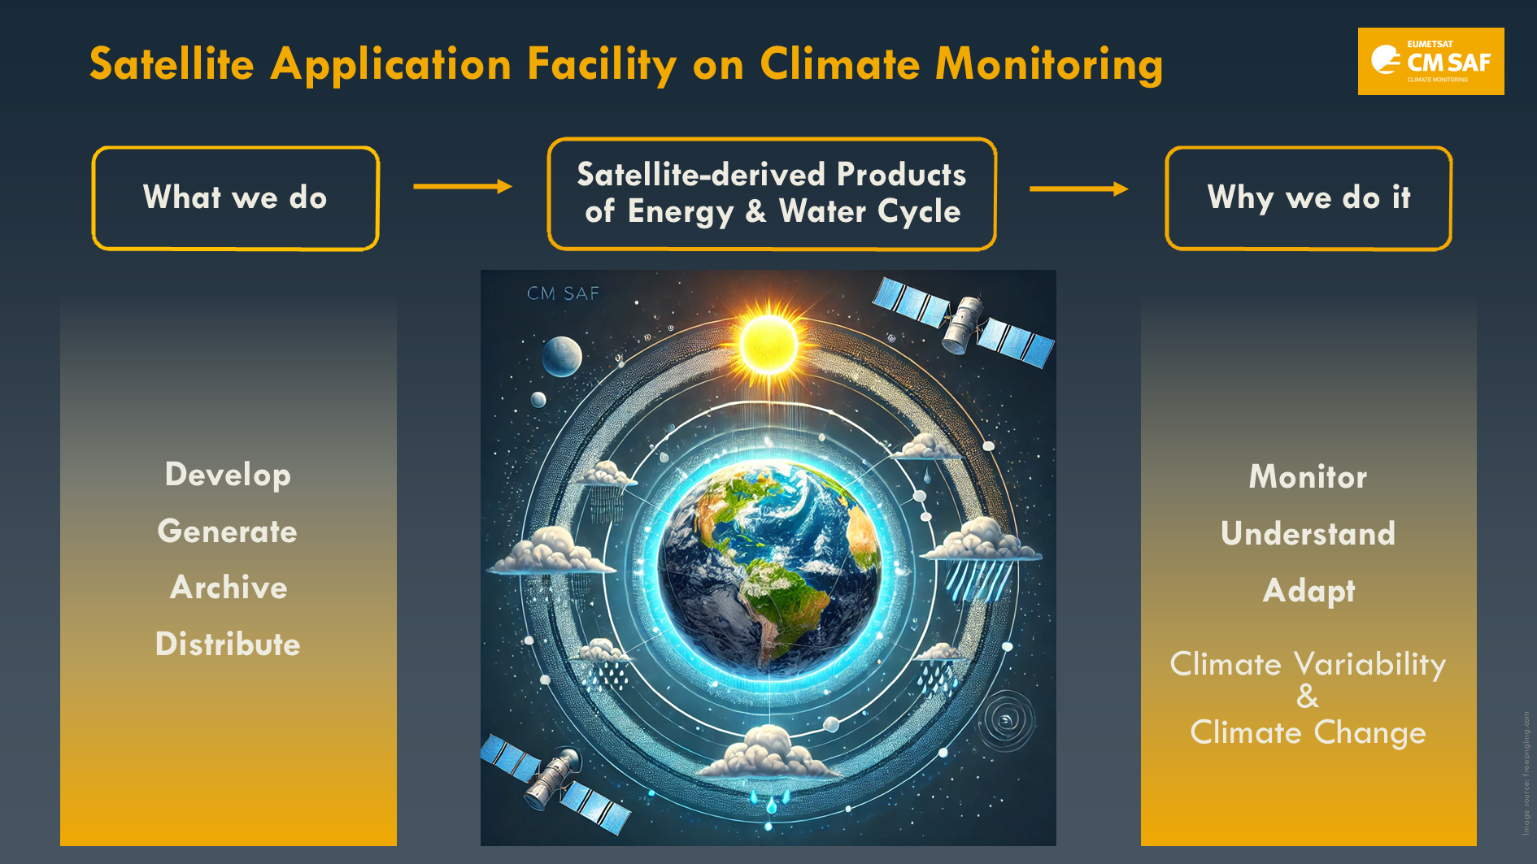

Slide 5
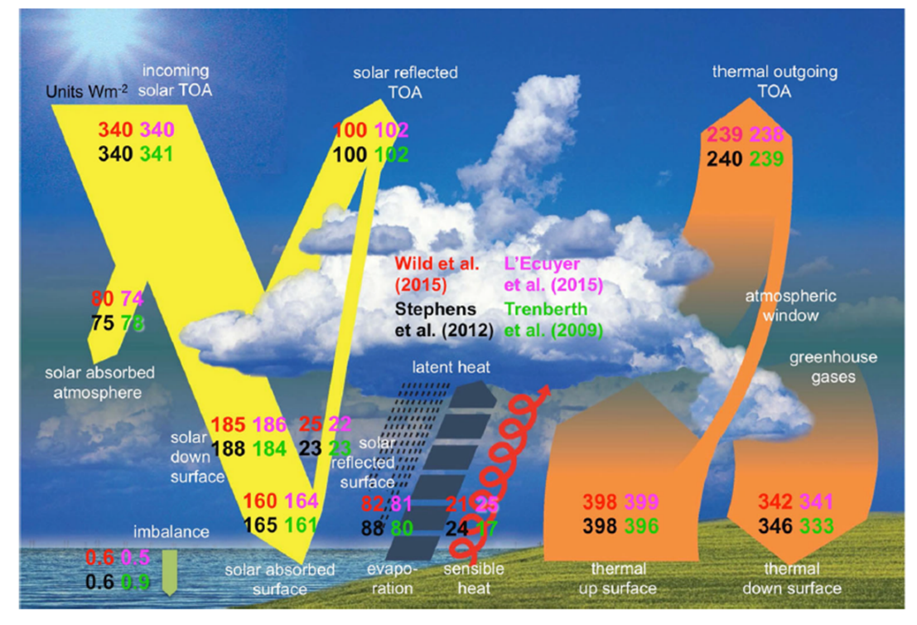
Our mission
CM SAF develops, generates, validates, archives and distributes high-quality satellite-derived products of the energy and water cycle suitable for climate monitoring, analysis, services and model evaluation, in a sustained operational environment.
CM SAF data sets
CLARA:
clouds, TOA and surface radiation, albedo
CLAAS:
clouds, (TOA radiation)
SARAH:
surface solar radiation
GIRAFE: Precipitation
LandFLux:
Land surface fluxes
HOAPS:
Ocean surface fluxes

Slide 6
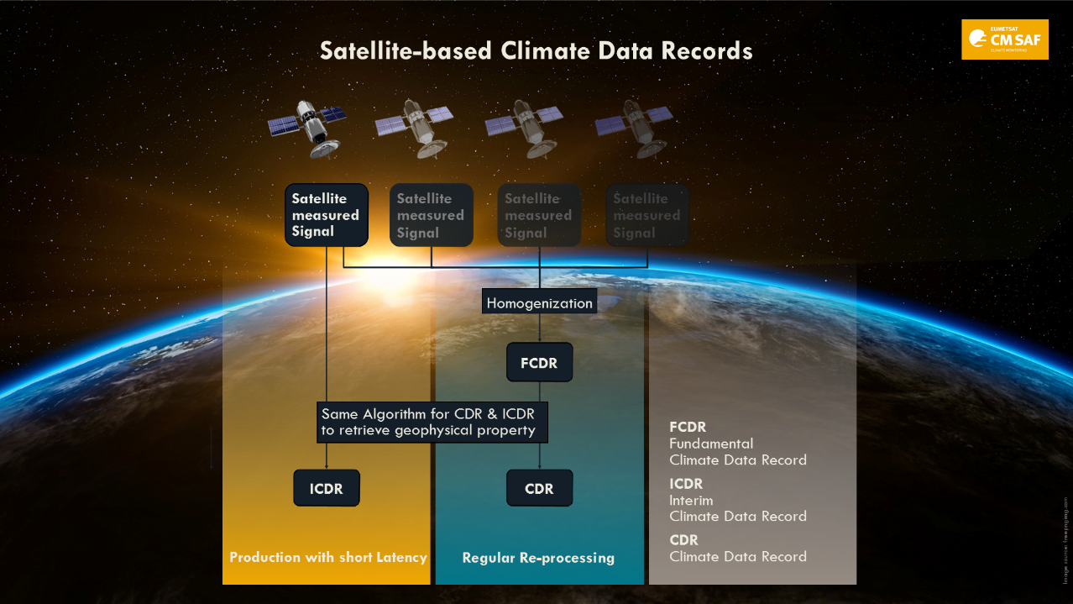
Climate Data Record (CDR)”: consists of a consistently-processed time series.
“Interim Climate Data record (ICDR)”: denotes a regularly updated CDR in shorter time latency.

Slide 7

Available CM SAF CDRs
Sensor, Satellite resp. | Parameter | CDR Period | Coverage
Fundamental Climate Data Record (FCDR)
SMMR, SSM/I, SSMIS | Microwave Radiances | 1979 – 2022 | global
Climate Data Record (CDR)
SEVIRI | Cloud parameters (frac., height, opt. dep., phase, eff. rad., LWP, IWP), AOD (-2012) (CLAAS*) | 2004 – 2020* | Regional
GERB/SEVIRI | Top of atmosphere radiative fluxes | 2004 – 2015
MVIRI/SEVIRI | Cloud frac. (COMET), Land Surface Temperature (SUMET), surface radiation budget, Latent + sensible heat flux (land), Free tropospheric humidity, Surface radiation (SARAH*) | 1983 – 2020 1983 – 2020 1983 – 2009 1983 – 2020*
AVHRR GAC | Cloud parameters, surface radiation parameters, incl. albedo, TOA radiation (CLARA*) | 1982 – 2020* | Global
Microwave imagers+ sounders, Geo-ring | Global precipitation (GIRAFE) | 2002 – 2022 (2024)*
SSM/I, SSMIS | HOAPS (precip, evap, hum., wind, ...) (ice-free ocean ) | 1987 – 2014
ATOVS | Water vapour and temperature profiles | 1999 – 2012
MSU, AMSU, SSM/T2, MHS | Upper troposphere humidity | 1994 – 2018
Microwave+NIR imagers | Total column water vapour with ESA WV_cci | 2002 – 2017
* ICDR service, data available until present time

Slide 8
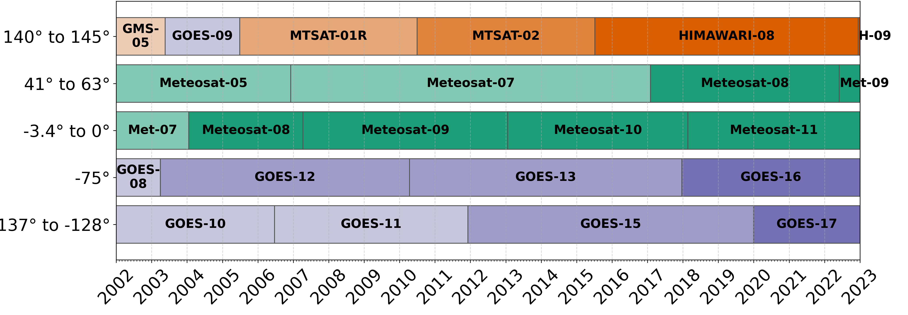
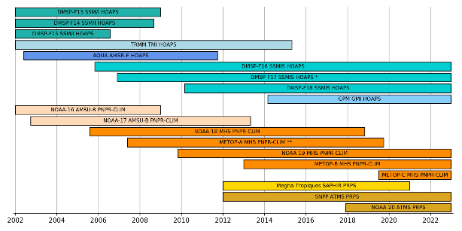
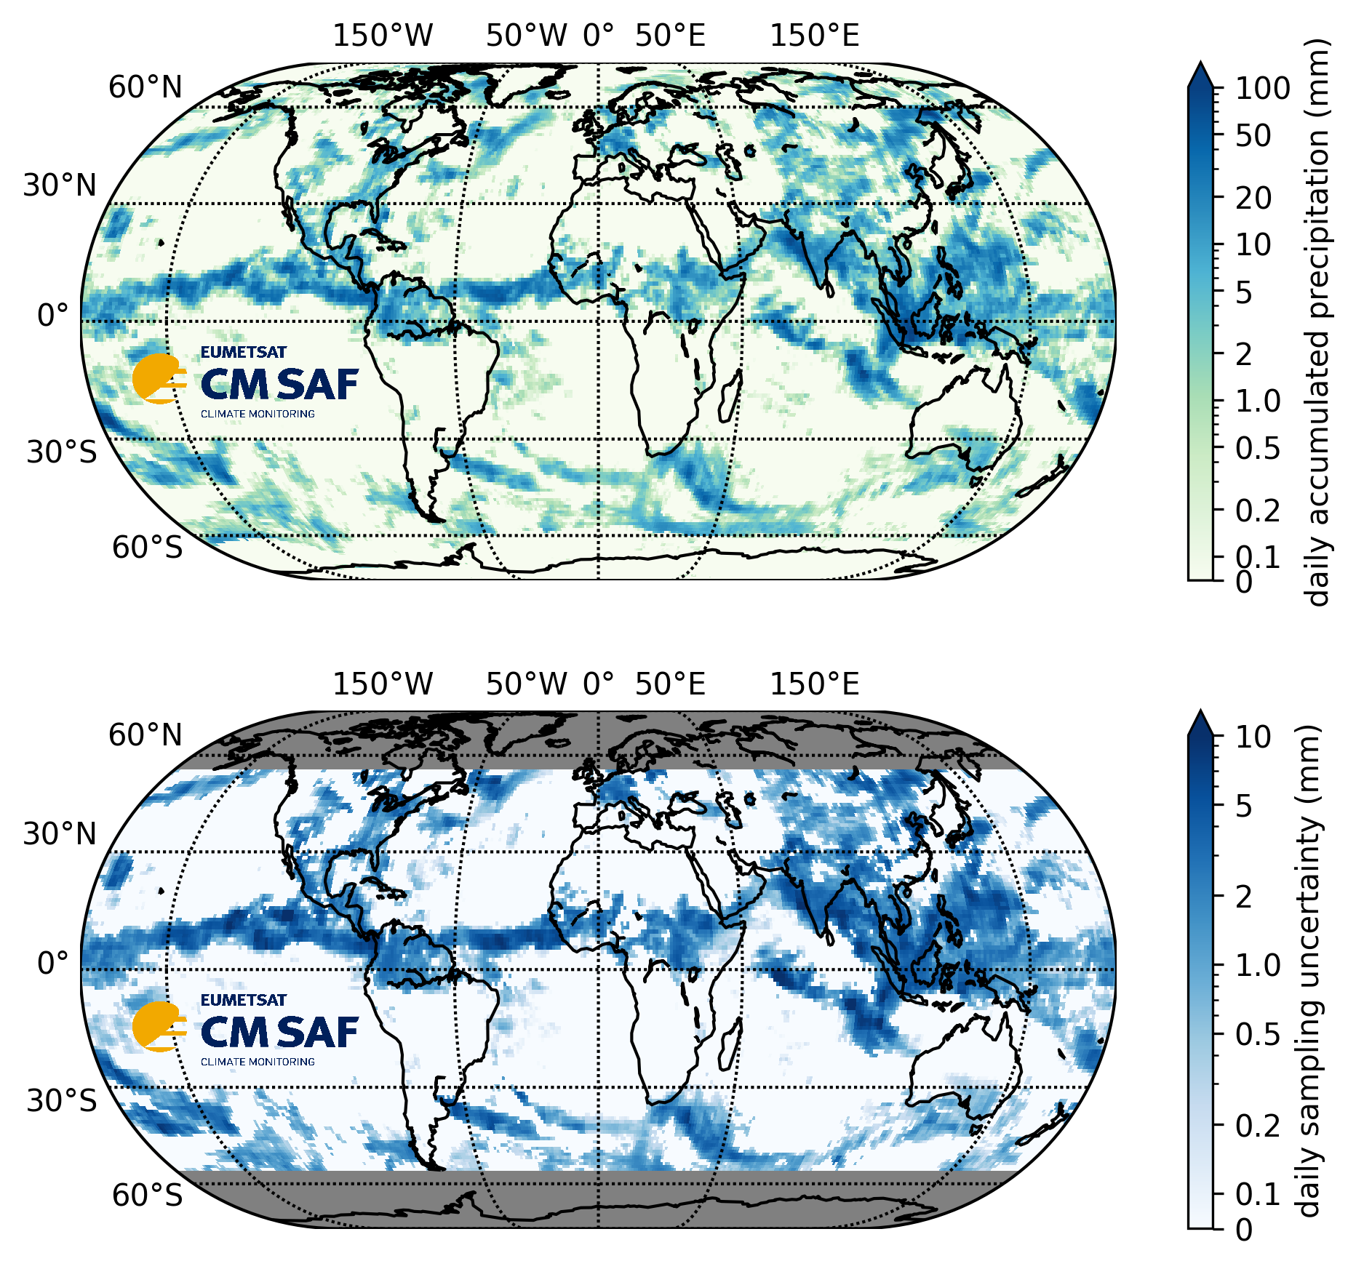
GIRAFE:
Global precipitation
Merging of microwave imager and sounder data with georing IR data: high accuracy (microwave) and high temporal sampling (IR)
+
13th July 2021
2002 - 2022
1° x 1° x 1 day accumulated precipitation and monthly averages
Uncertainty for daily data
No adjustment towards rain gauge datasets in v1
Extension with ICDR version in development
doi: 10.5676/EUM_SAF_CM/GIRAFE/V001
Konrad, H., et al.: GIRAFE v1: a global climate data record for precipitation accompanied by a daily sampling uncertainty, ESSDD, https://doi.org/10.5194/essd-2024-568, in review, 2025.

Slide 9
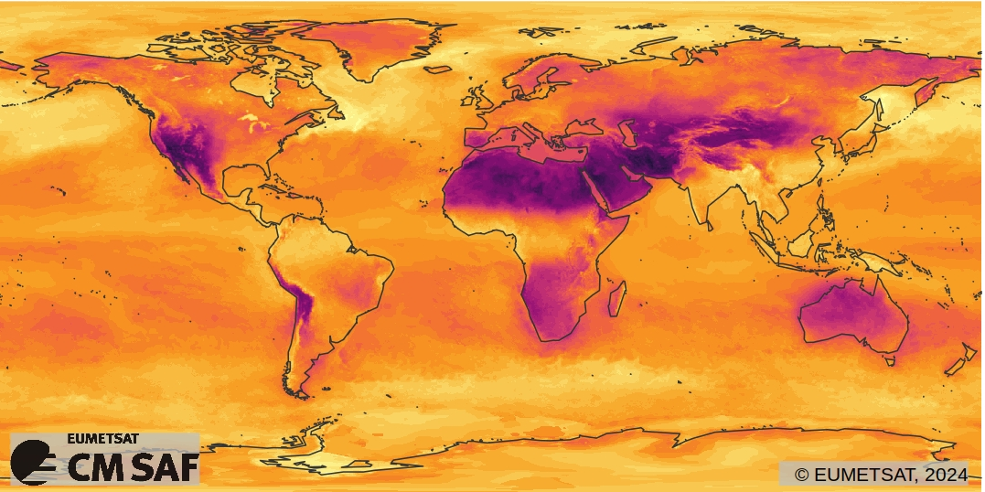
CLARA-A3
Variables
Cloud properties (fraction, height, microphysical properties)
Surface albedo
SurfaceRadiation
TOA Radiation
Resolution
Spatial: 0.25°×0.25°
(+ polar projections 25 x 25 km)
Temporal: daily, pentad, monthly
Coverage
Spatial: global
Temporal: 1979 to date
DOI:10.5676/EUM_SAF_CM/CLARA_AVHRR/V003
Surface Net Longwave Radiation(SNL)
Karlsson, K.-G. et al., (2023): CLARA-A3: The third edition of the AVHRR-based CM SAF climate data record on clouds, radiation and surface albedo covering the period 1979 to 2023, Earth Syst. Sci. Data, 15, 4901–4926, doi: 10.5194/essd-15-4901-2023

Slide 10
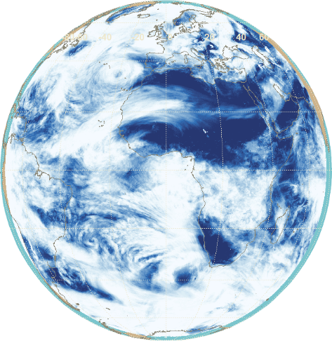
CLAAS-3
Variables
Cloud properties (fraction, height, phase)
Liquid and ice water path
CLAAS-4: top-of-atmosphere radiation
Resolution
Spatial: native, 0.05°×0.05°
Temporal: 15 min, hourly, daily, monthly, mean diurnal cycle
Coverage
Spatial: Meteosat disk
Temporal: 2004 to date
DOI:10.5676/EUM_SAF_CM/CLAAS/V003
Cloud Fractional Coverage (CFC)
Benas, N. et al., (2023): CLAAS-3: the third edition of the CM SAF cloud data record based on SEVIRI observations, Earth Syst. Sci. Data, 15, 5153–5170, doi: 10.5194/essd-15-5153-2023

Slide 11
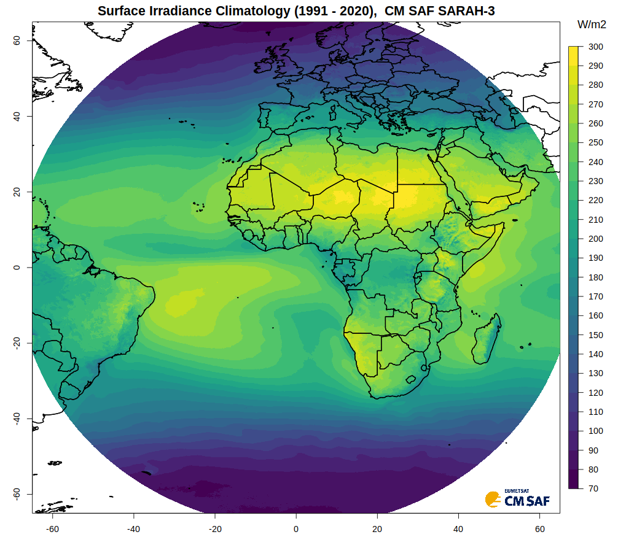
CM SAF SARAH-3
Surface Solar Radiation Dataset – Heliosat
DOI:10.5676/EUM_SAF_CM/SARAH/V003
Variables
  Surface Solar Irradiance (SIS)
  Surface Direct Irradiance (SID, DNI)
  Sunshine Duration (SDU)
  Photosynthetic Active Radiation (PAR)
  Daylight (DAL)
  Effective Cloud Albedo (CAL)
Resolution
  Spatial: 0.05° × 0.05°
  Temporal: 30-min, daily-, monthly mean
Coverage
  Spatial: regional (±65°)
  Temporal: 1983 to date
Pfeifroth, U., et al.,: SARAH-3 – satellite-based climate data records of surface solar radiation, Earth Syst. Sci. Data, 16, 5243–5265, doi: 10.5194/essd-16-5243-2024, 2024.

Slide 12
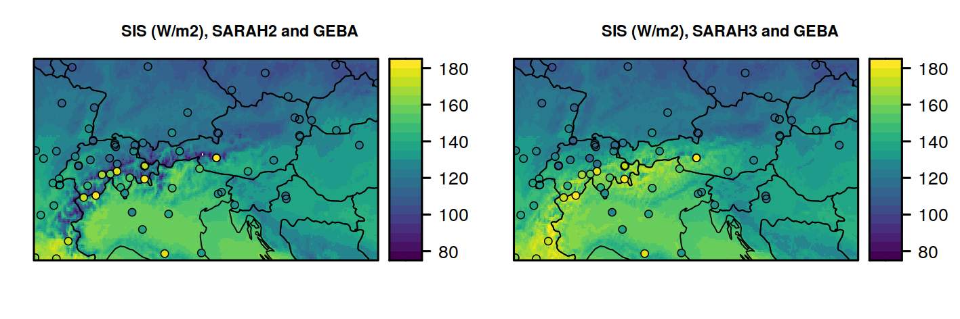
SARAH-3
Improved surface irradiance over snow
SARAH-3 has higher (more realistic) surface irradiance in alpine regions
March Climatologies
Stations: GEBA - Global Energy Budget Archive

Slide 13
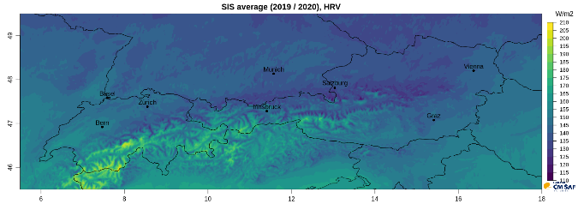
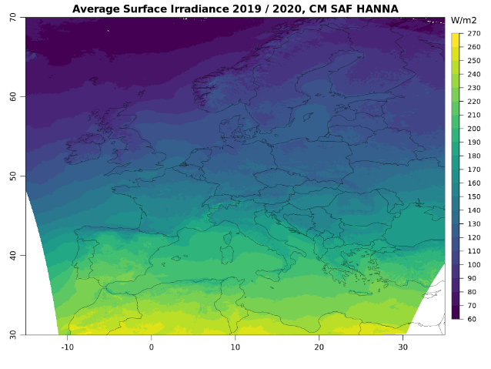
CM SAF HANNA
Demonstrational data set
Variables
  Surface Solar Irradiance (SIS)
Resolution
  Spatial: 0.01° × 0.01°
  Temporal: 15-min, daily-, monthly mean
Coverage
  Spatial: Europe
  Temporal: 2019 + 2020
https://www.cmsaf.eu/demo_hanna

Slide 14
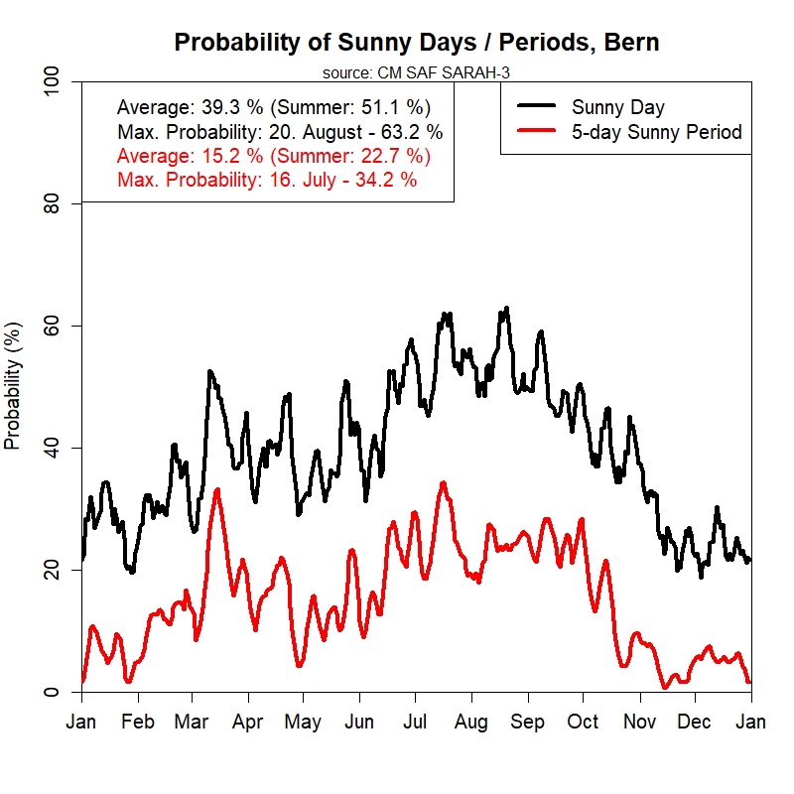
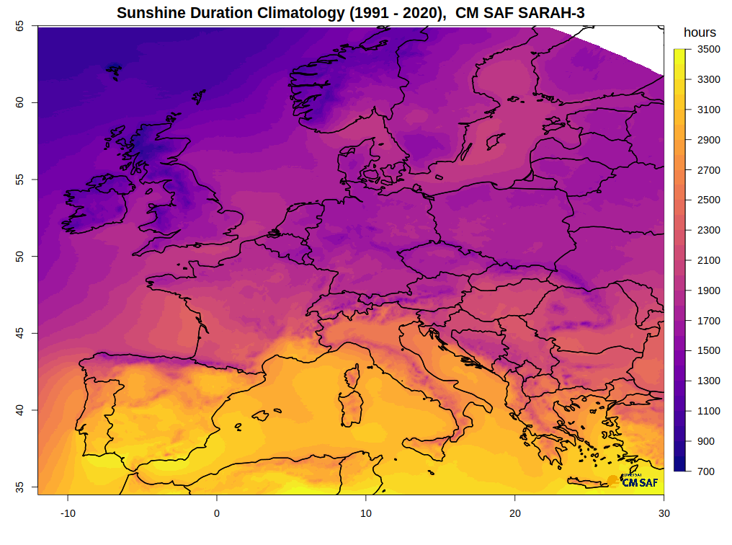
Applications of the data

Slide 15
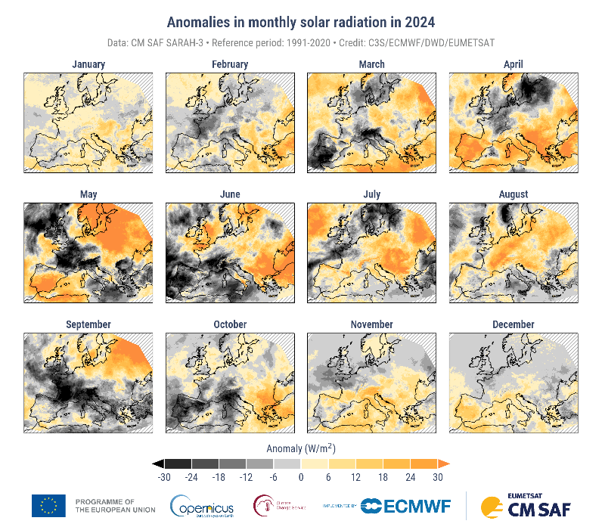
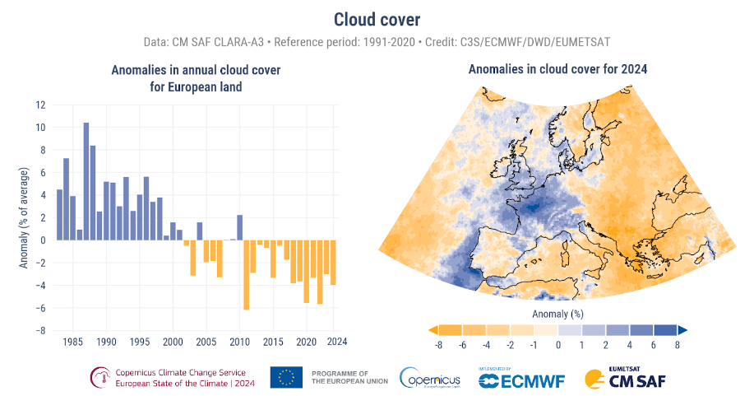
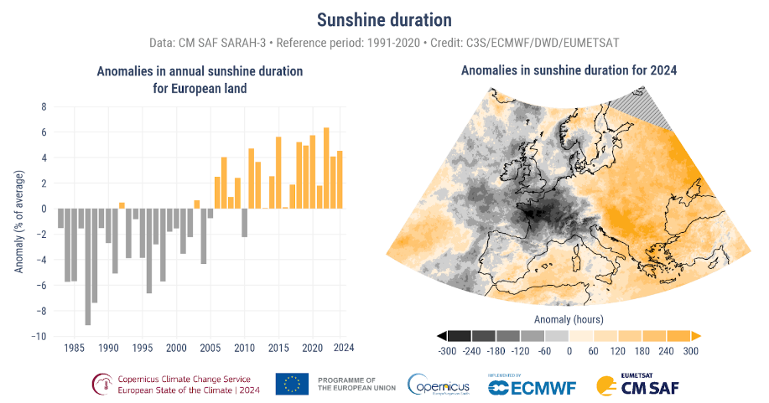
European State of Climate 2024
Cloud cover
Sunshine duration
Distinct East-West contrast, with more hours of sunshine and higher surface solar radiation (SARAH) towards the East, corresponding with low cloud coverage (CLARA)
Largest positive anomalies in solar radiation in spring / early summer.
https://climate.copernicus.eu/esotc/2024/clouds-and-sunshine

Slide 16
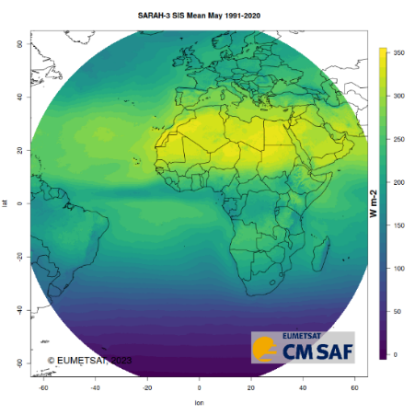
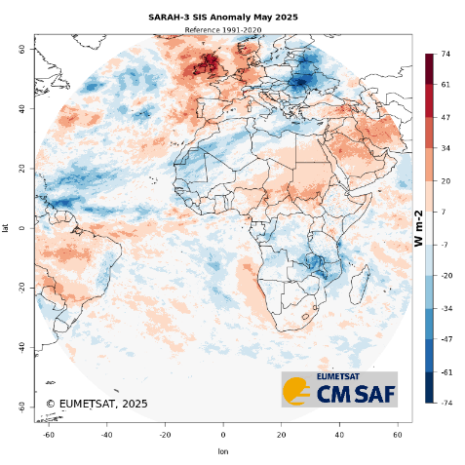
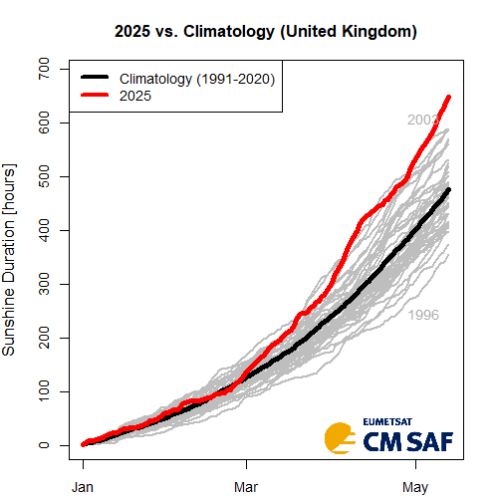
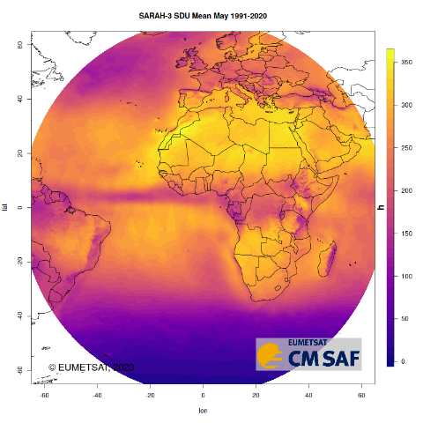
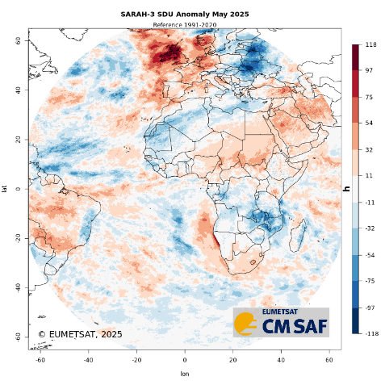

Climate normals and anomalies
(SIS and SDU from SARAH-3)
Accumulated sunshine
duration until 13 May, UK
CM SAF plans to provide climate normals and climate anomalies.
Details:
WMO reference period 1991-2020
Operational quality control
Embedded in a EUMETSAT wide activity, guided by a Task Team
2025: 650 h
2003: 590 h
Climate normal, 1991-2020
SDU SIS
Monthly anomaly
SIS May 2025 SDU

Slide 17



What is the CM SAF R Toolbox?
R-based
cmsafops – Analysis
cmsafvis – Visualization
cmsaf – GUI & Preparation
Prepare
Ready-to-use NetCDF files
Analyze
Data analysis and manipulation
GUI or Command Line
Apply via graphical user interface or directly via command line
Visualize
Data visualization and info
Freely available
All R-packages freely available via CRAN (https://cran.r-project.org/)

Slide 18
Conclusions
Large variety of freely available, satellite-based climate data records with operational extension:
  www.cmsaf.eu
Regular reprocessing and adaptation of service based on evolution of user requirements and opportunities
New developments include, among others,
  Towards global evapotranspiration
  Geo-ring based products (e.g. SARAH-4)
  Climate normals and anomalies

Slide 19

Thank you very much for your attention.
Questions?
Contact data:
www.cmsaf.eu
contact.cmsaf@dwd.de
joerg.trentmann@dwd.de

Slide 21

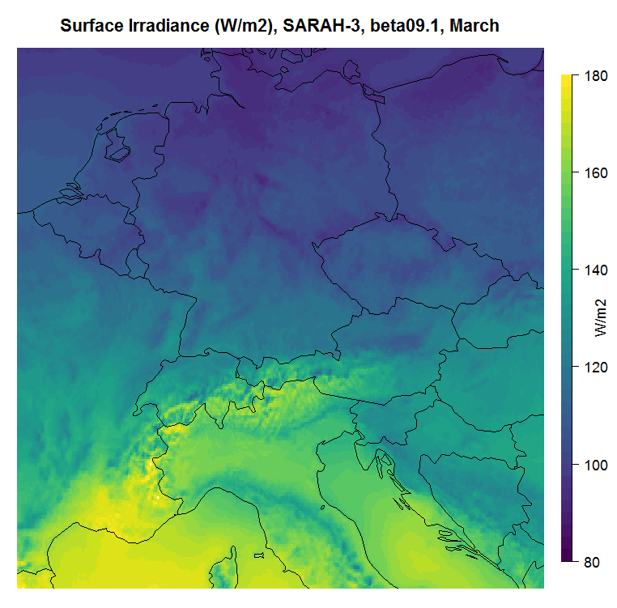
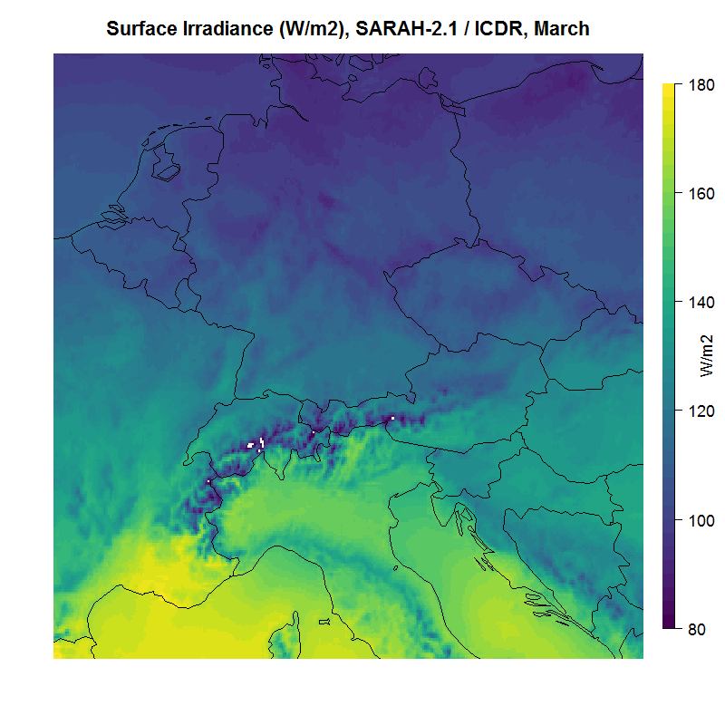
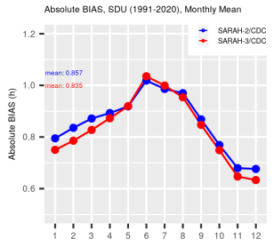
Surface Radiation, Climatology, March 1983 - 2020
SARAH-3: Snow Coverage
Substantially enhanced (and much more realistic!) surface radiation in the Alpine region in SARAH-3
SARAH-3
SARAH-2

Slide 22
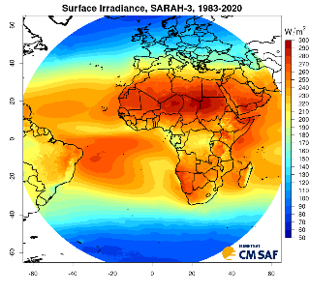
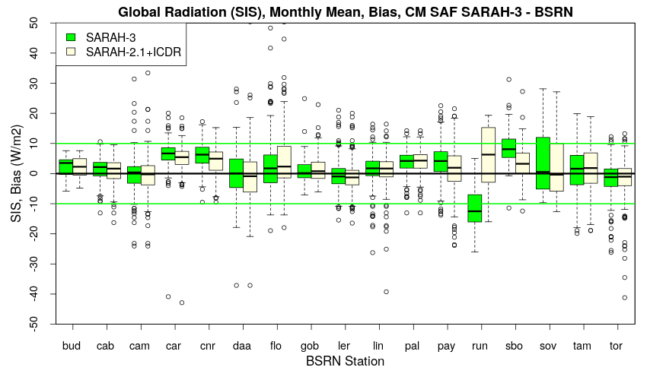
SARAH-3 CDR and ICDR
SARAH-3: Surface Solar Radiation Data Set - Heliosat
Surface radiation using MVIRI and SEVIRI data
CDR: 1983-2020 (12 different prime satellites).
ICDR: January 2021 onwards, all parameters (2 different prime satellites)
Resolution: 0.05°, instantaneous, daily, monthly
  daily sums, monthly (SDU)
DOI: 10.5676/EUM_SAF_CM/SARAH/V003
Pfeifroth et al., 2023
Example validation results for SIS using BSRN data as reference

Slide 23
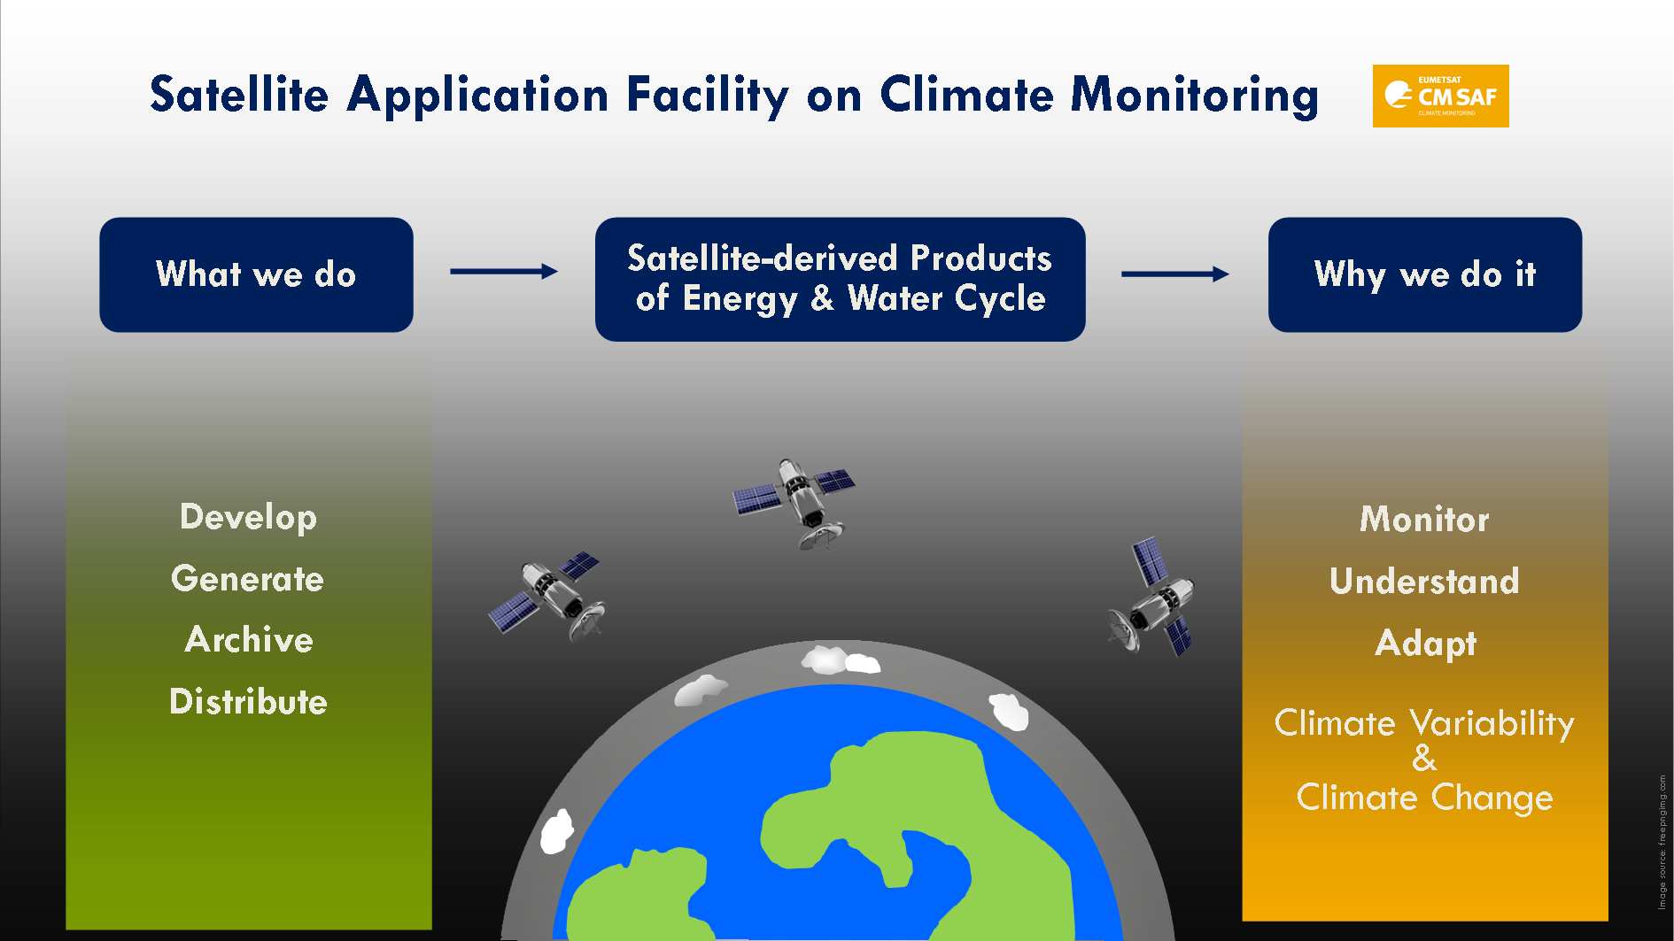

Slide 24
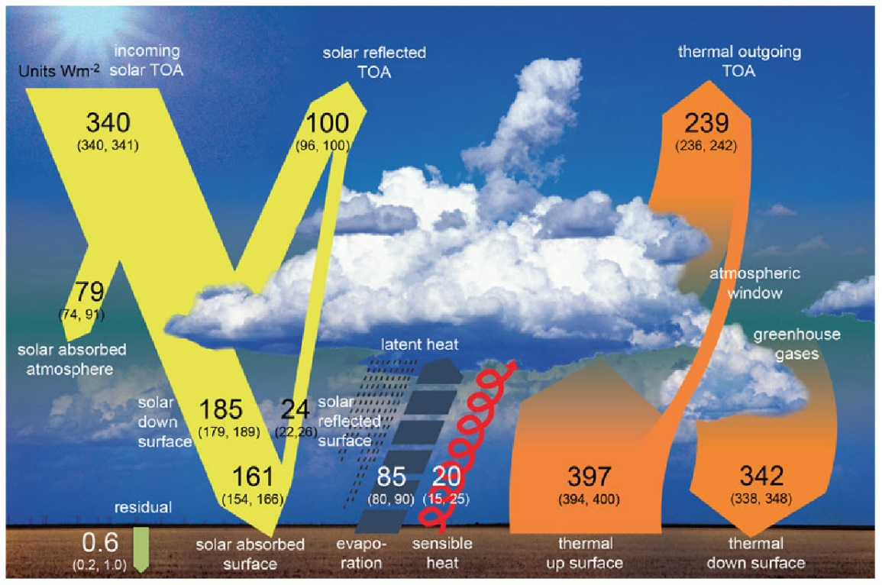
What we do
CM SAF develops, generates, validates, archives and distributes high-quality satellite-derived products of the energy and water cycle suitable for climate monitoring, analysis, services and model evaluation, in a sustained operational environment.
Source:
Wild et al., 2013

Slide 25
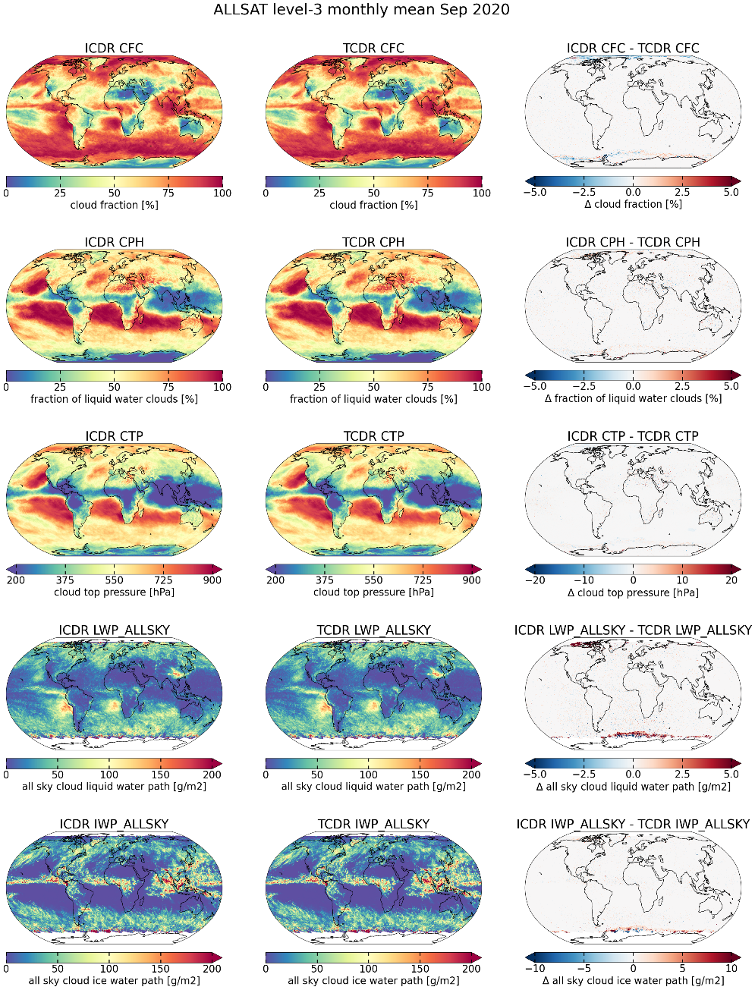
CDR and ICDR
“Climate Data Record (CDR)”: consists of a consistently-processed time series.
“Interim Climate Data record (ICDR)”: denotes a regularly updated CDR in shorter time latency.
In CM SAF CDR and ICDR processing systems (latencies: 5 - 15 days) are usually identical with the objective to achieve identity between CDR and ICDR.
Exceptions arise from differences in input data due to constraints on availability (latency) and effort (FCDR quality).
Validation:
Comparison to CDR using data from overlap period,
Annual validation through comparison to reference data.
ICDR – CDR, CLARA-A3
differences - sea-ice (CDR vs NRT OSI SAF product), ERA5/ERA5T, L1 FDR (EUMETSAT / CM SAF).

Slide 26
Upcoming versions of CM SAF CDRs
Sensor, Satellite resp. | Parameter | CDR Period | Coverage
Fundamental Climate Data Record (FCDR)
SMMR, SSM/I, SSMIS | Microwave Radiances | 1979 – 2024 | global
Climate Data Record (CDR)
SEVIRI | Cloud parameters (frac., height, opt. dep., phase, eff. Rad., LWP, IWP) (CLAAS*) | 2004 – 2024* | Regional
Geo-ring | Land surface temp., latent+sensible heat flux, SRB | Demo CDOP4, CDOP5 | Global
Geo-ring | Cloud products, TOA radiation, TBD | ISCCP-NG demo**
AVHRR GAC | Cloud parameters, surface radiation parameters, albedo, TOA radiation (CLARA*) | 1979 – 2024* | Global
SSM/I, SSMIS, TMI, GMI, AMSR-E, AMSR2 | HOAPS 5 (precip, evap, hum., wind, ..) Ice-free ocean | 1987 – 2024
Geo-ring | Surface radiation (SARAH*-4) | 1983 – 2025*
MSU, AMSU, SSM/T2, MHS Microwave+NIR imagers | Upper troposphere humidity Total column water vapour with ESA WV_cci | 1994 – 2023 2000 – 2022

Slide 27
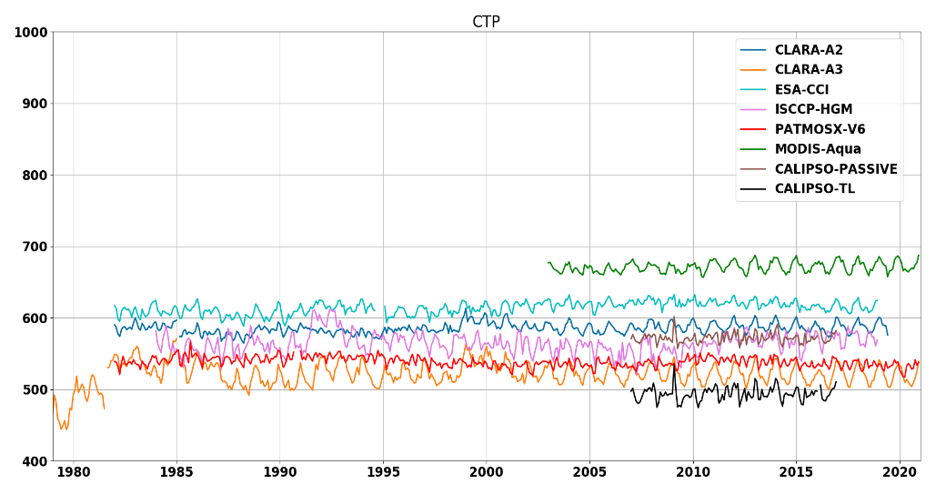
CLARA-A3 CDR and ICDR
CLARA-A3: CM SAF Clouds, Albedo and Radiation dataset from AVHRR data Edition 3
Contains a large product suite including albedo, cloud parameters, surface radiation, and TOA radiation.
Enhanced product suite: SNS and SNL in CDR and SNS, SNL, SDL, and SRB in ICDR
CDR: 1979-2020 (1 - 6 satellites)
ICDR: January 2021 onwards, all parameters (currently 4 satellites), Metop-C removed from ICDR; updated calibration needed.
Resolution: 0.25°, daily, monthly
0.05° instantaneous (clouds)
25 x 25 km² (polar regions, A+clouds)
DOI: 10.5676/EUM_SAF_CM/CLARA_AVHRR/V003
TOA
Example intercomparison results for cloud top pressure
Karlsson, K.-G et al.: CLARA-A3: The third edition of the AVHRR-based CM SAF climate data record on clouds, radiation and surface albedo covering the period 1979 to 2023, Earth Syst. Sci. Data, 15, 4901–4926, https://doi.org/10.5194/essd-15-4901-2023, 2023.
Notes:
Processing delays due to change to new processing environment and associated delays.
First results indicate issue in latest data; this needs to be better understood (and before the way forward is proposed.)

